Slide 1
Visit bit.ly/ire25-cleaning
Jonathan Soma
Knight Chair in Data Journalism
Columbia Journalism School
js4571@columbia.edu
jonathansoma.com/everything

Slide 2
Why not AI?

Slide 3
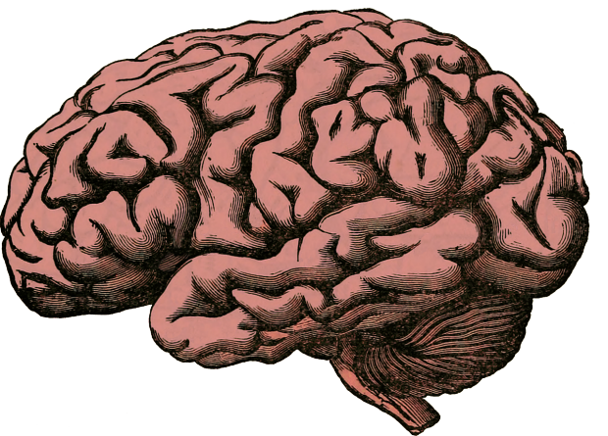
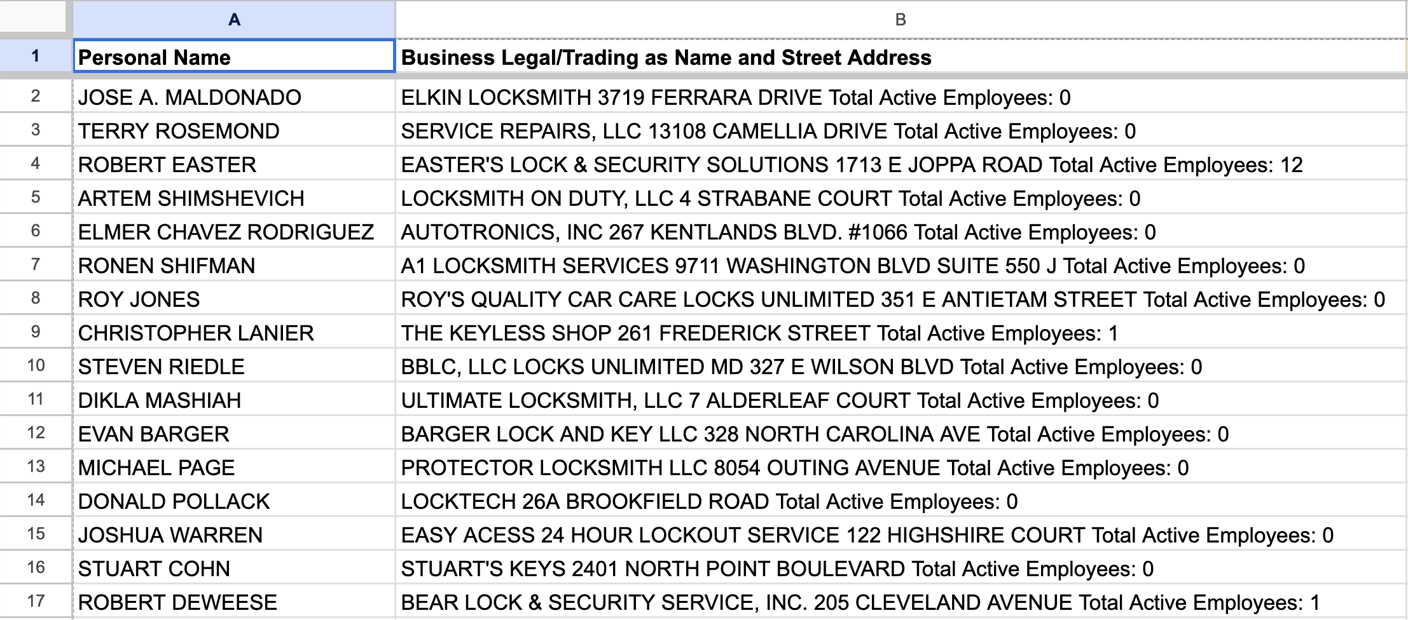
Context window

Slide 4
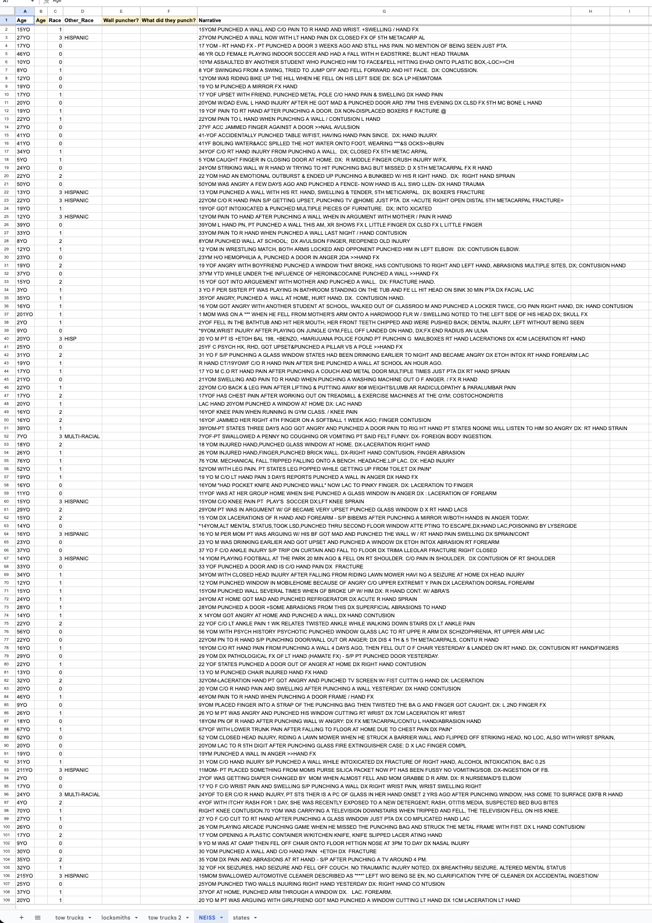


Context window

Slide 5
Why to not use AI for data cleaning
It gets things wrong
You won’t double-check it
It makes your brain rot away and you never learn new skills
(okay but actually we WILL use AI today)
It gets things wrong!!!

Slide 6
Basic concepts
replace and split are 99% of the game

Slide 7


66 years old
replace “ years old”
with… nothing!
66 years old
convert to number
66

Slide 8


j soma, js4571@columbia.edu, @dangerscarf
split on “, “
j soma js4571@columbia.edu @dangerscarf
take second piece
js4571@columbia.edu

Slide 9





j soma, js4571@columbia.edu, @dangerscarf
split
j soma js4571@columbia.edu @dangerscarf
take second
js4571@columbia.edu
split on @
replace with nothing
js4571 columbia.edu
js4571@columbia.edu
take second
columbia.edu

Slide 10
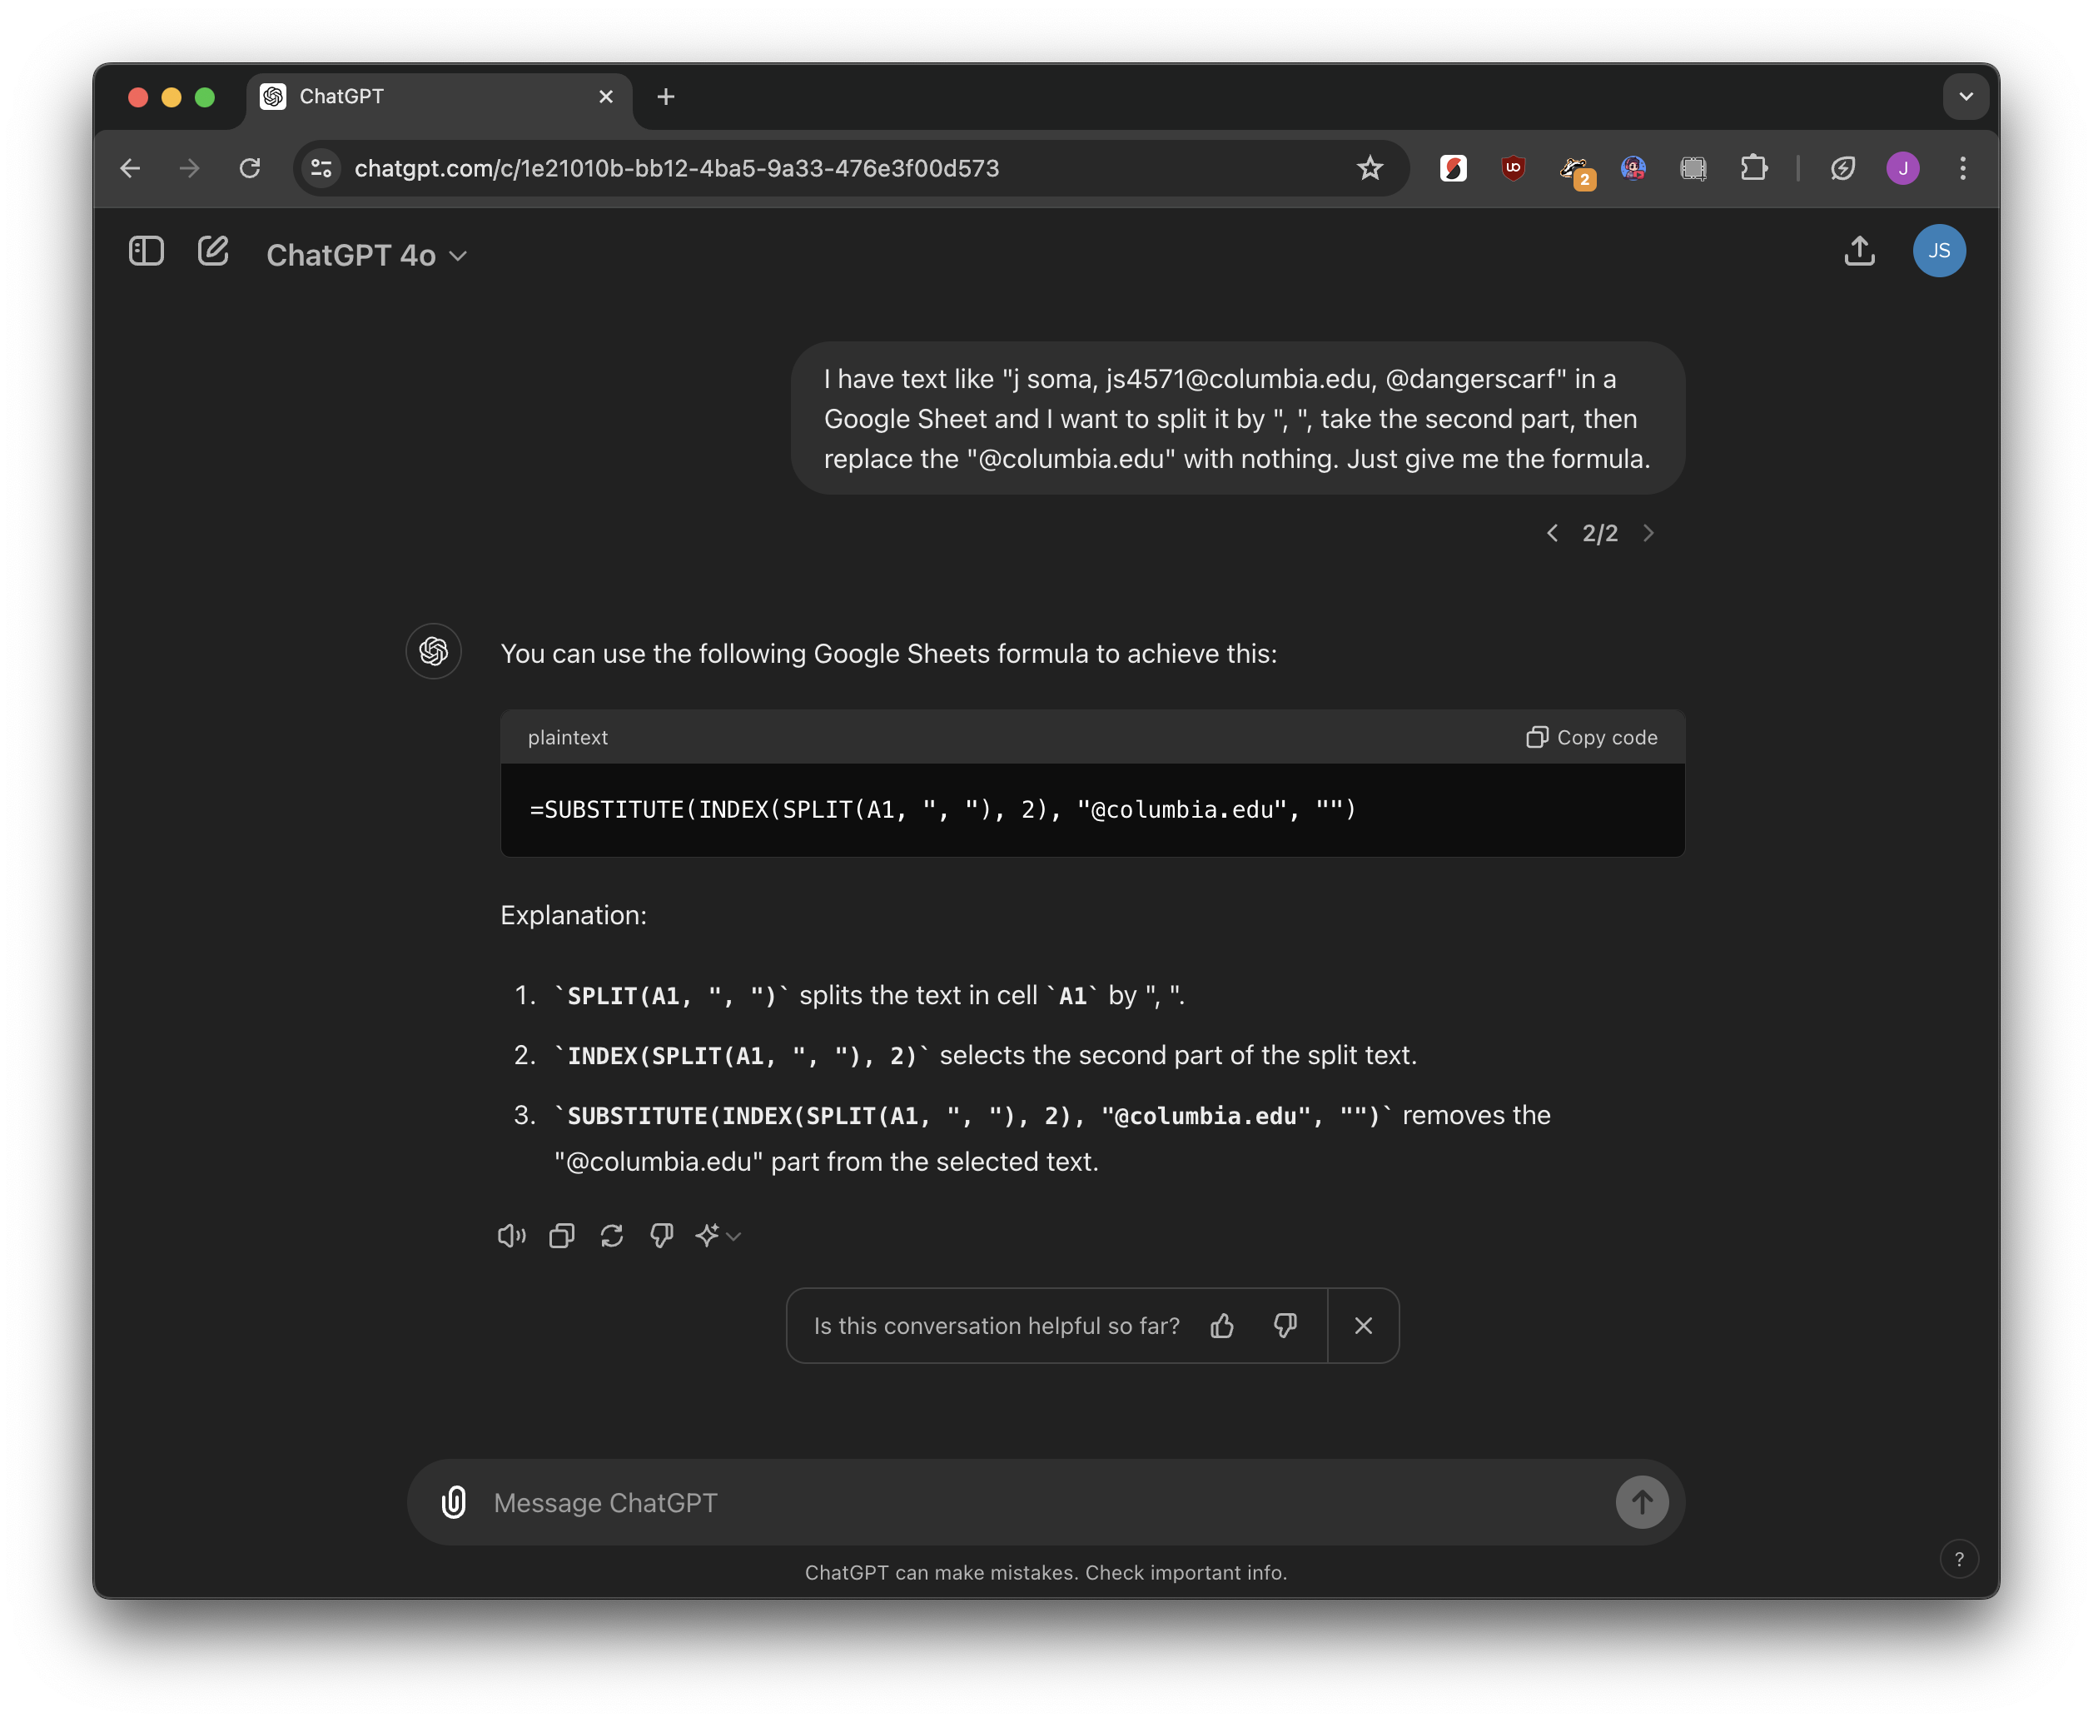
just ask!
then TEST IT

Slide 11
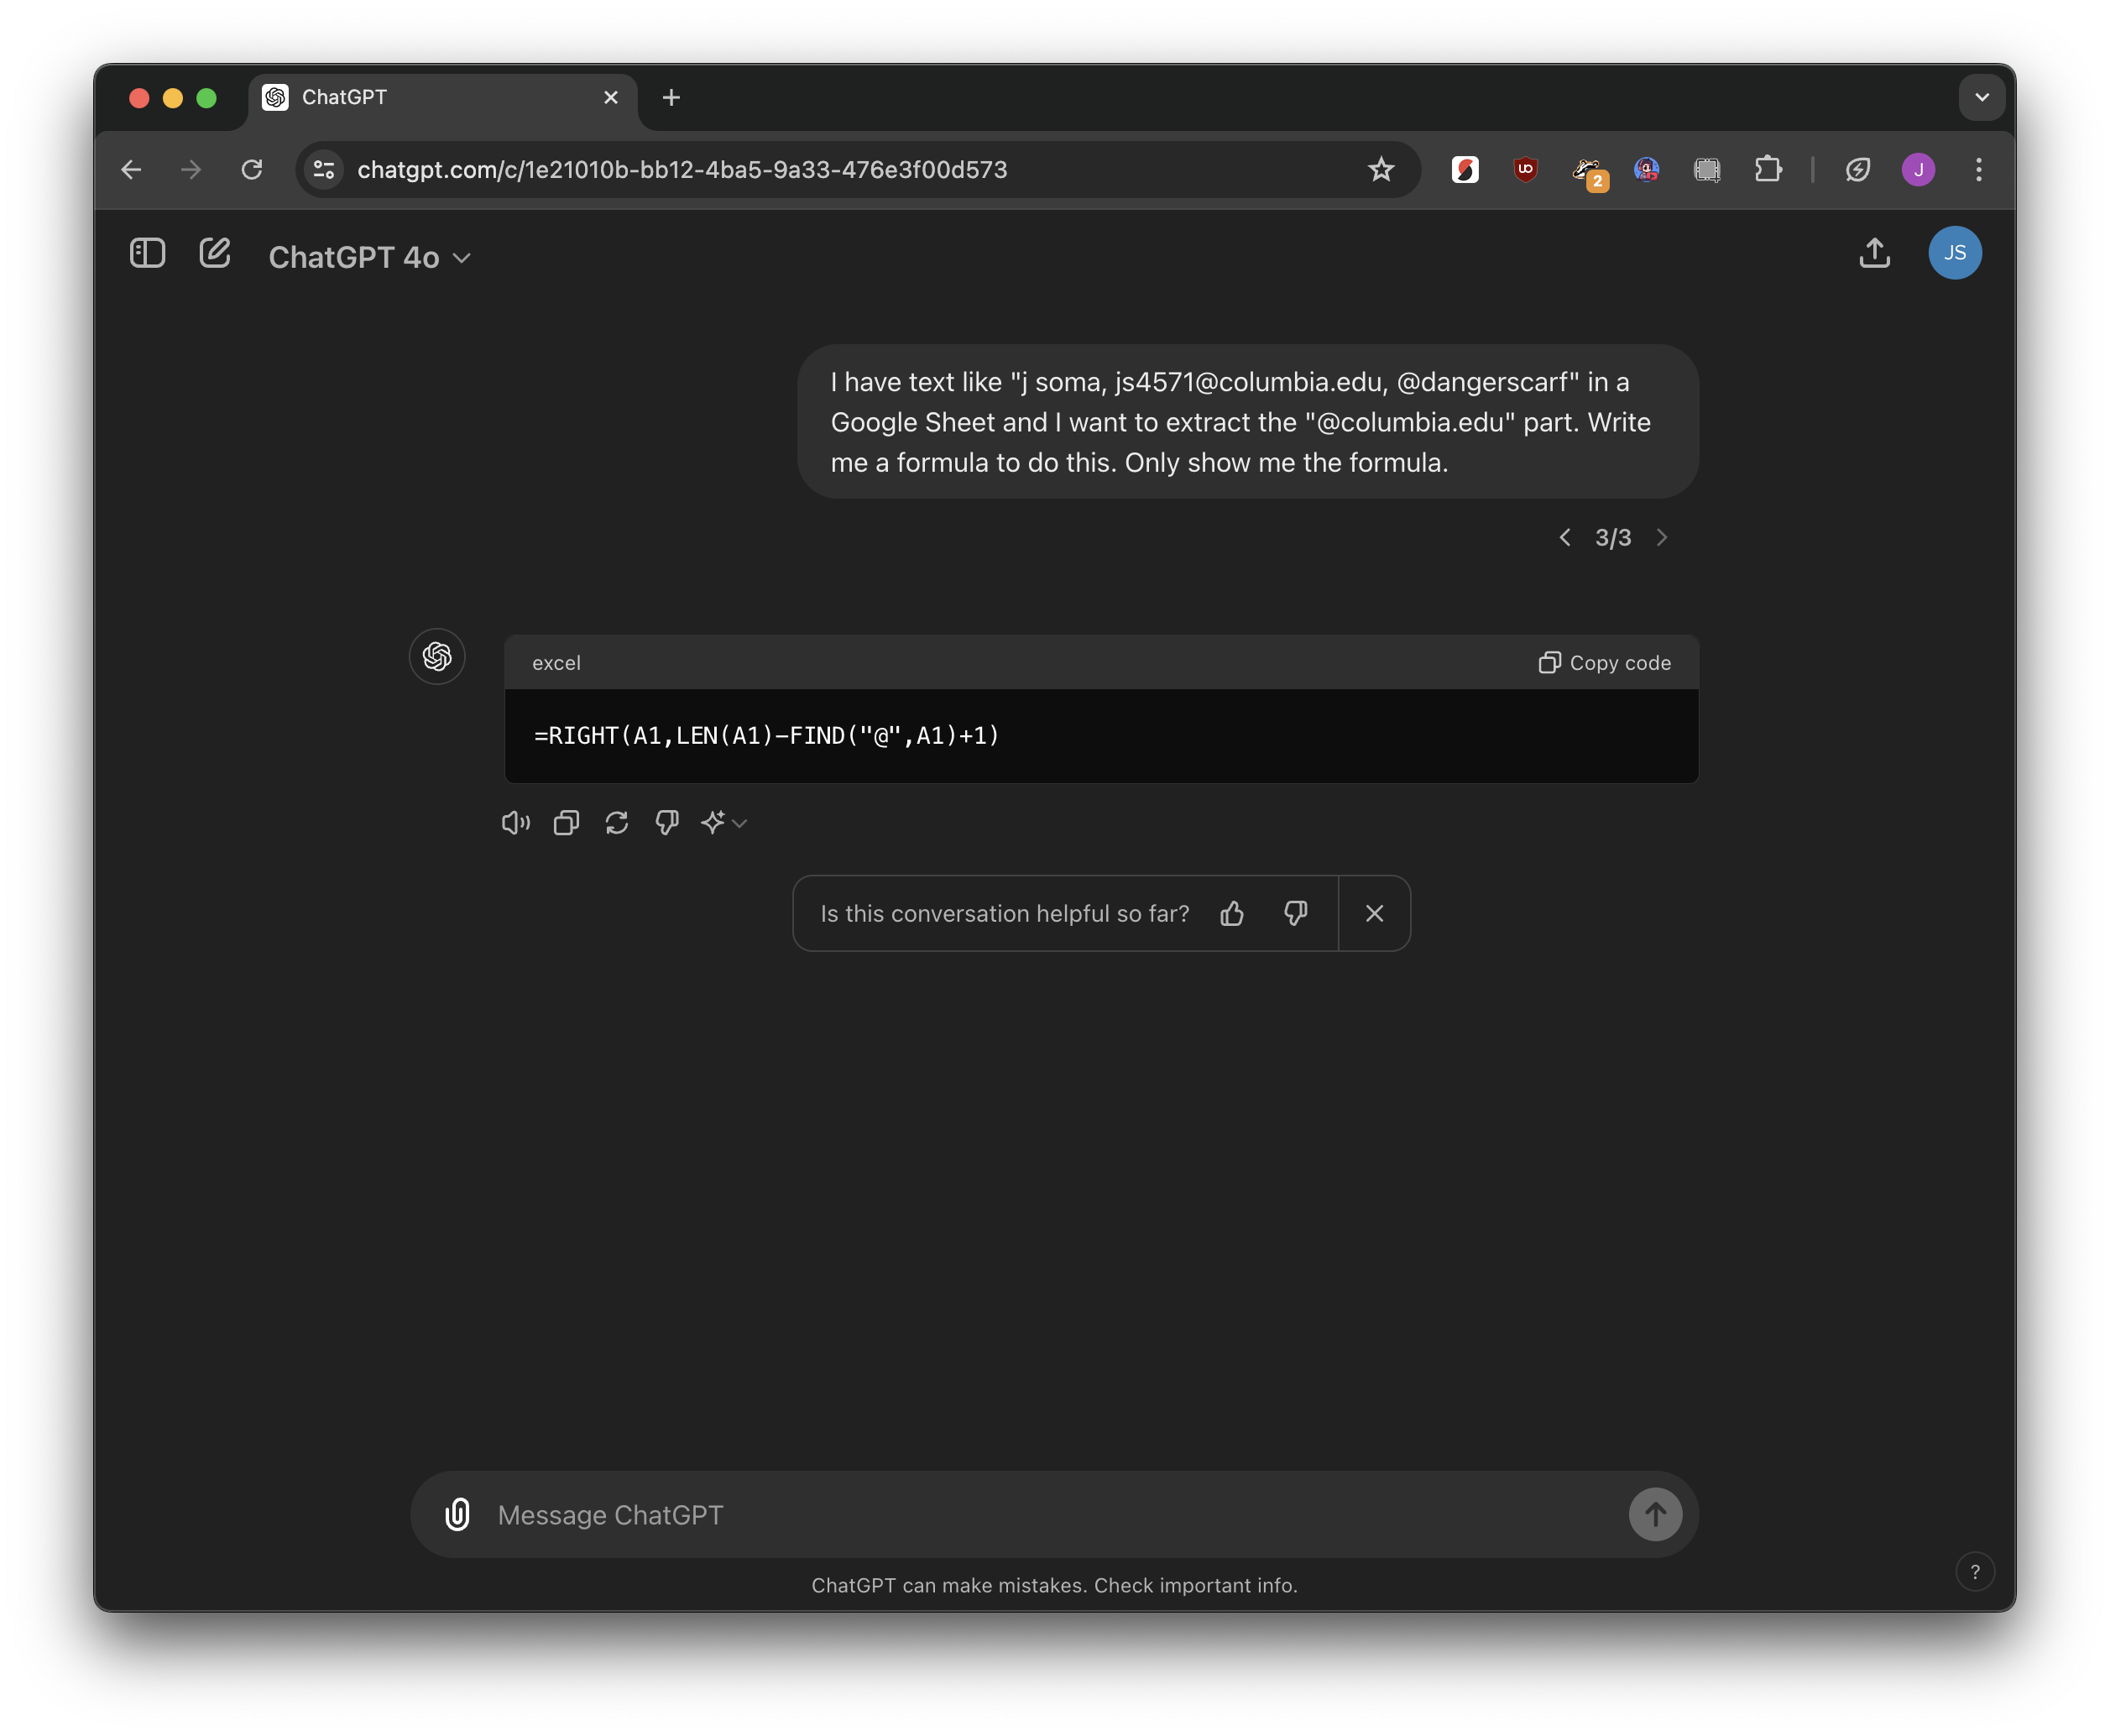
just ask!
then TEST IT

Slide 12

Feel free to reach out at 555-555-5555
take the final 12 letters
555-555-5555

Slide 13
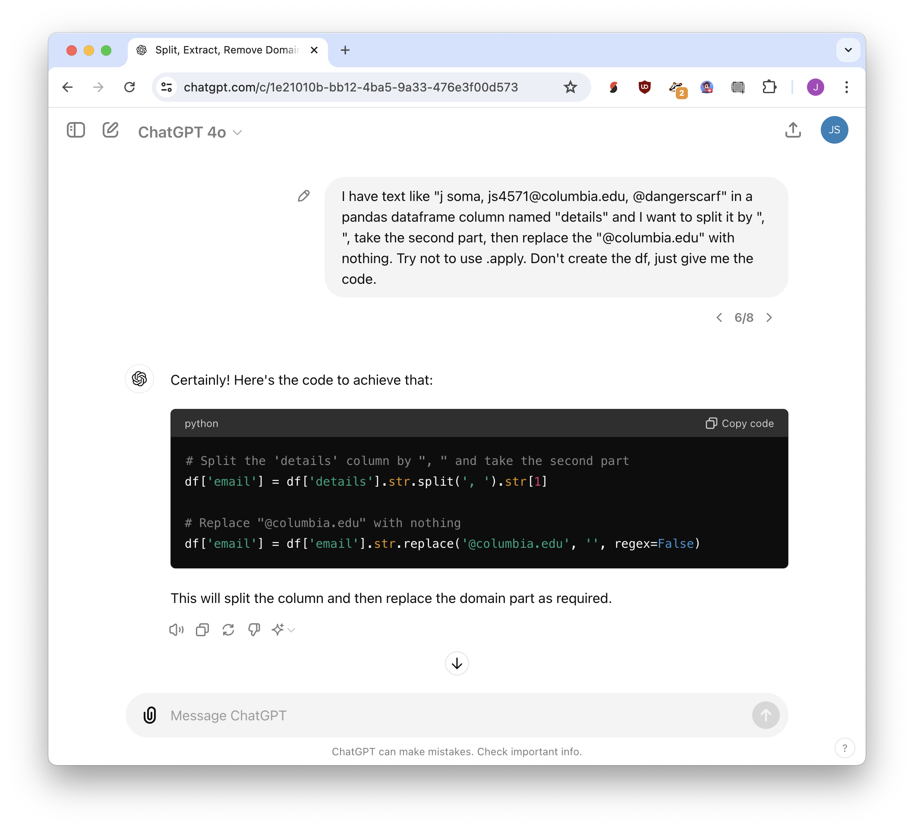
just ask!
then TEST IT

Slide 14
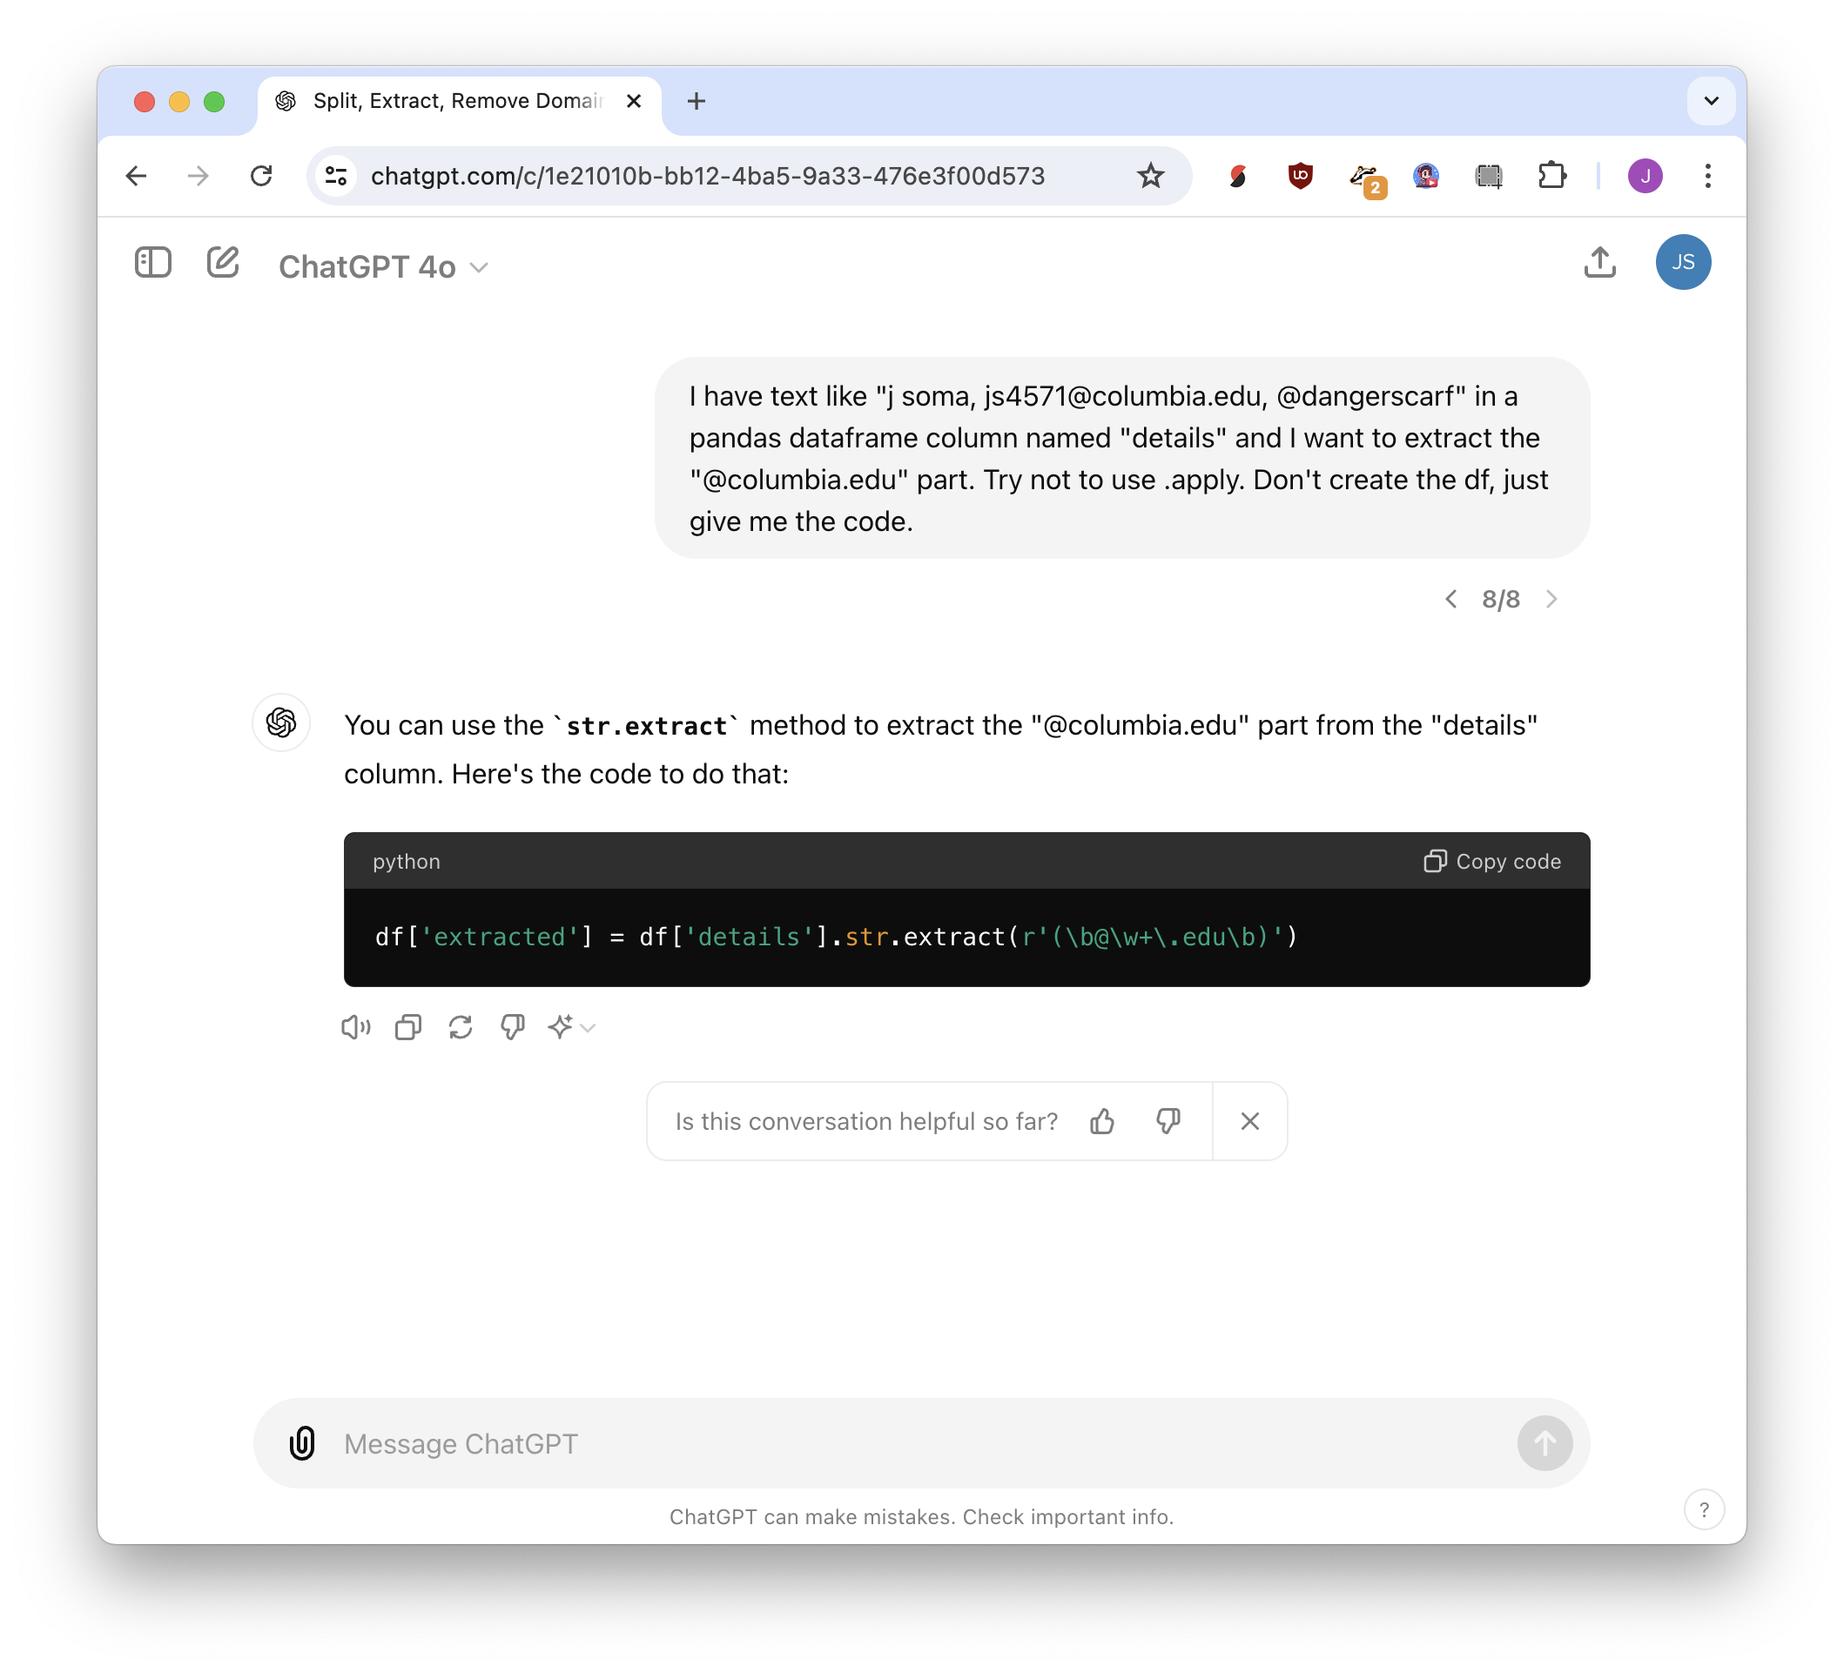
just ask!
then TEST IT

Slide 15
Regular expressions
regex is the other other 1%

Slide 16


66 years old
hug what we want
(capture group)
(66) years old
match anything
(.*) years old

Slide 17


I am 66 years old
hug what we want
I am (66) years old
match anything
I am (.*) years old
demand numbers
I am (\d*) years old

Slide 18




Contact me at 555-555-5555
hug what we want
Contact me at (.*)
but maybe not!
Contact me at 555-555-5555 or js4571@columbia.edu
Contact me at (\d\d\d-\d\d\d-\d\d\d\d)
just numbers

Slide 19

Contact me at 555-555-5555
maybe we don’t
need an anchor?
(\d\d\d-\d\d\d-\d\d\d\d)

Slide 20
Contact me at 5555555555
maybe hyphens are optional?
(\d\d\d-?\d\d\d-?\d\d\d\d)

Slide 21
Contact me at 555+555+5555
any character is fine!
(and also optional)
(\d\d\d.?\d\d\d.?\d\d\d\d)

Slide 22
Google Sheets
REGEXMATCH("Spreadsheets", "S.r")
REGEXEXTRACT(”I ate 24 cakes 2 days ago", "\d+")
REGEXREPLACE("Spreadsheets", "S.*d", "Bed")
Python (pandas)
df[‘colname’].str.extract(“(\d*)”)
(and many more)

Slide 23
Google Sheets
.* - literally anything
\d – digits
\w+ – more than one “word” characters
[A-Za-z] – all letters
\s - whitespace
\b\w{5}\b – 5-letter words
^https?://\S+ - URLs

Slide 24
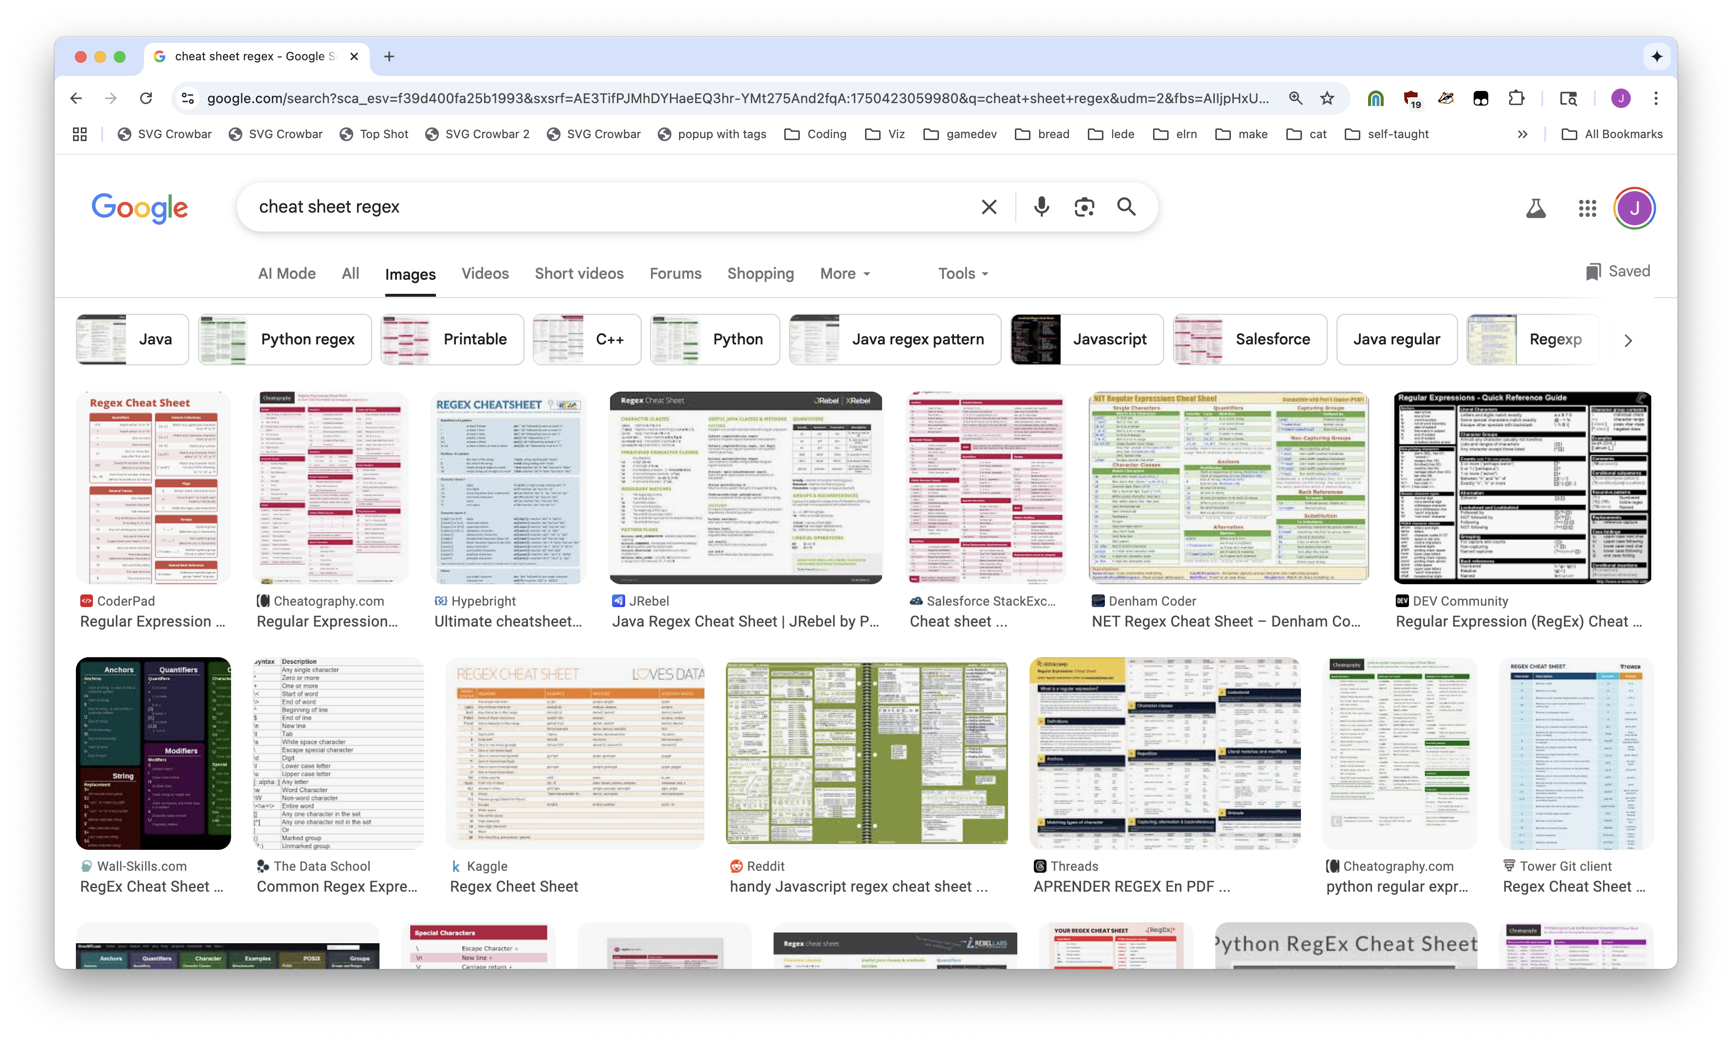

Slide 25
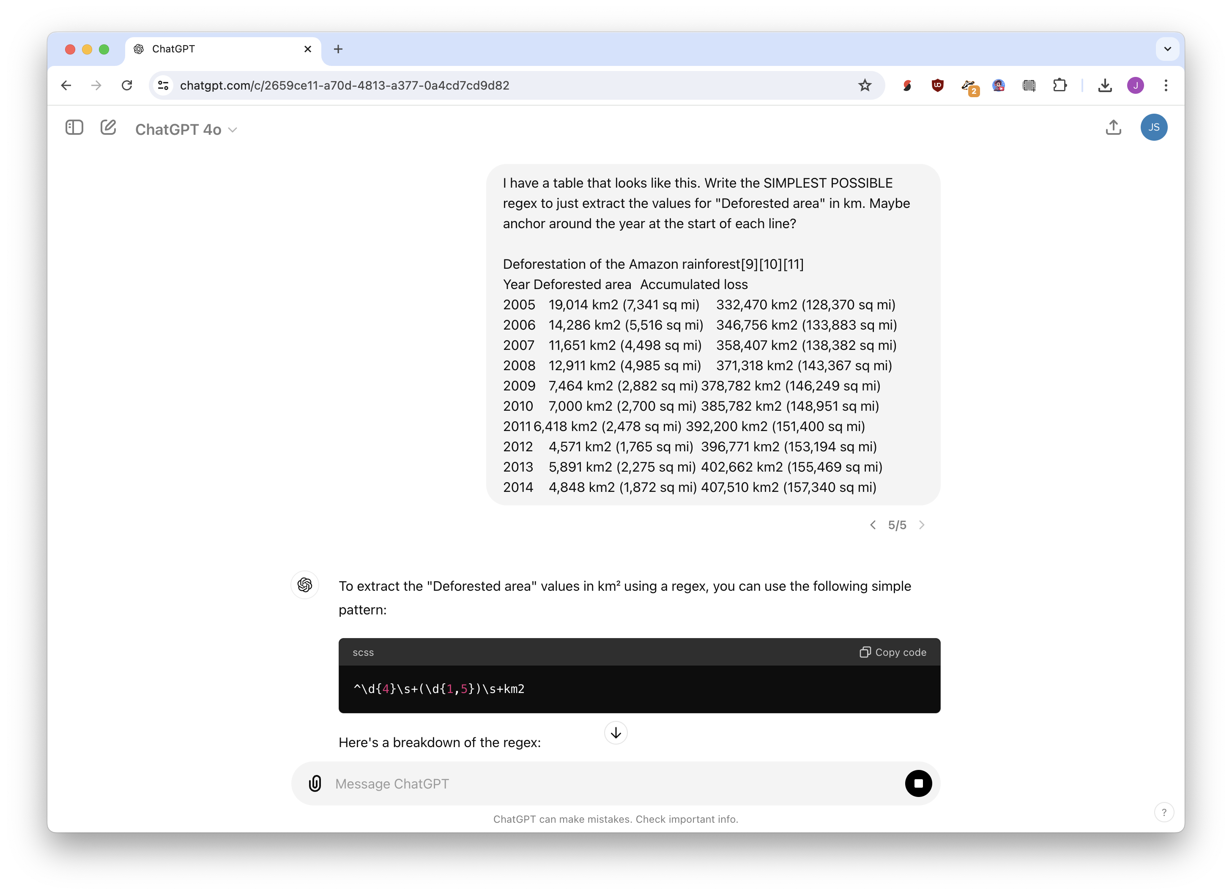
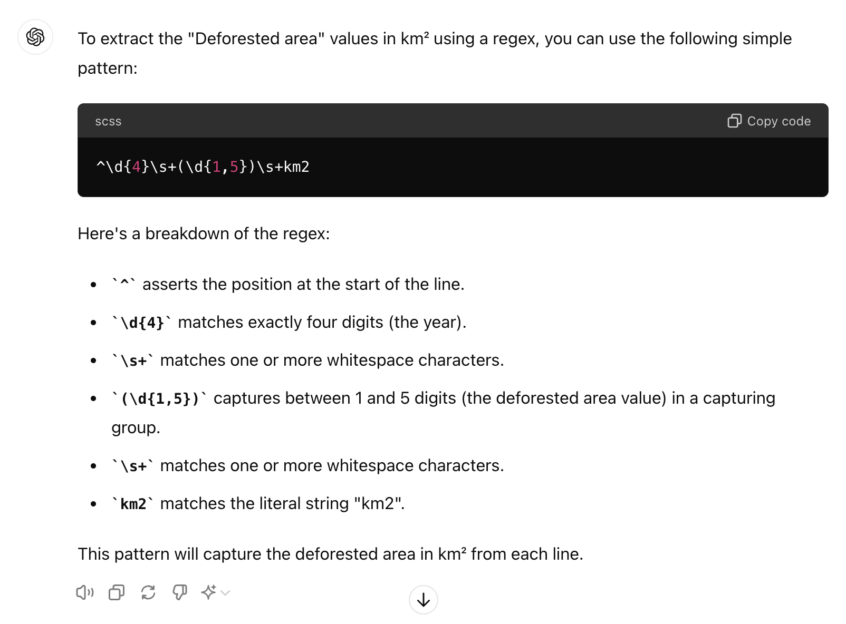
just ask!
then TEST IT

Slide 26
Doing things multiple times

Slide 27
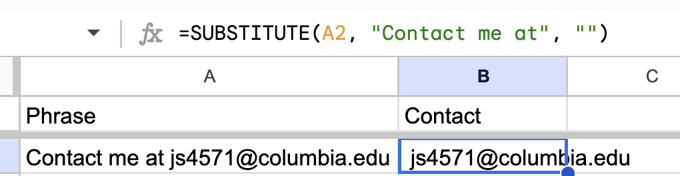
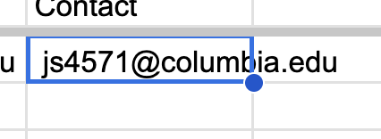
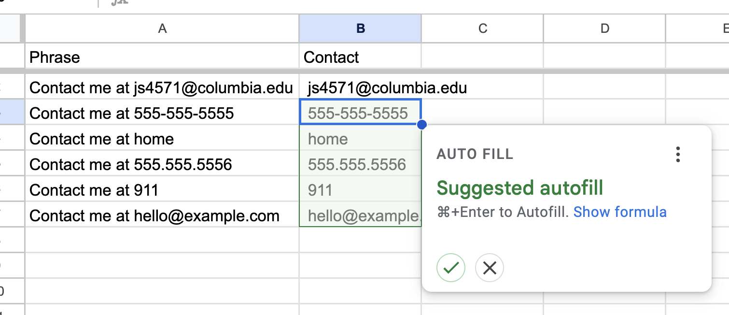


click + drag
autofill

Slide 28
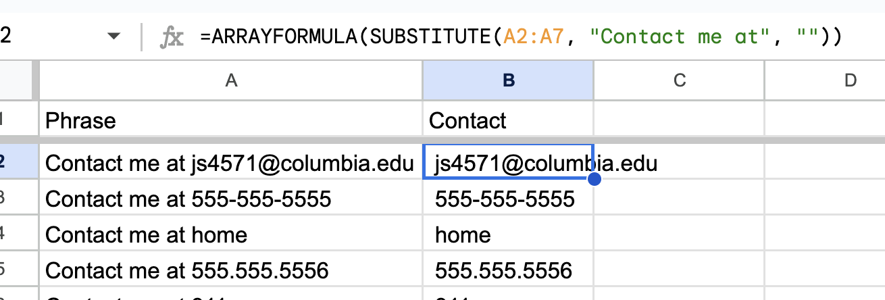

=ARRAYFORMULA(……)

Slide 29
Fuzzy matching

Slide 30
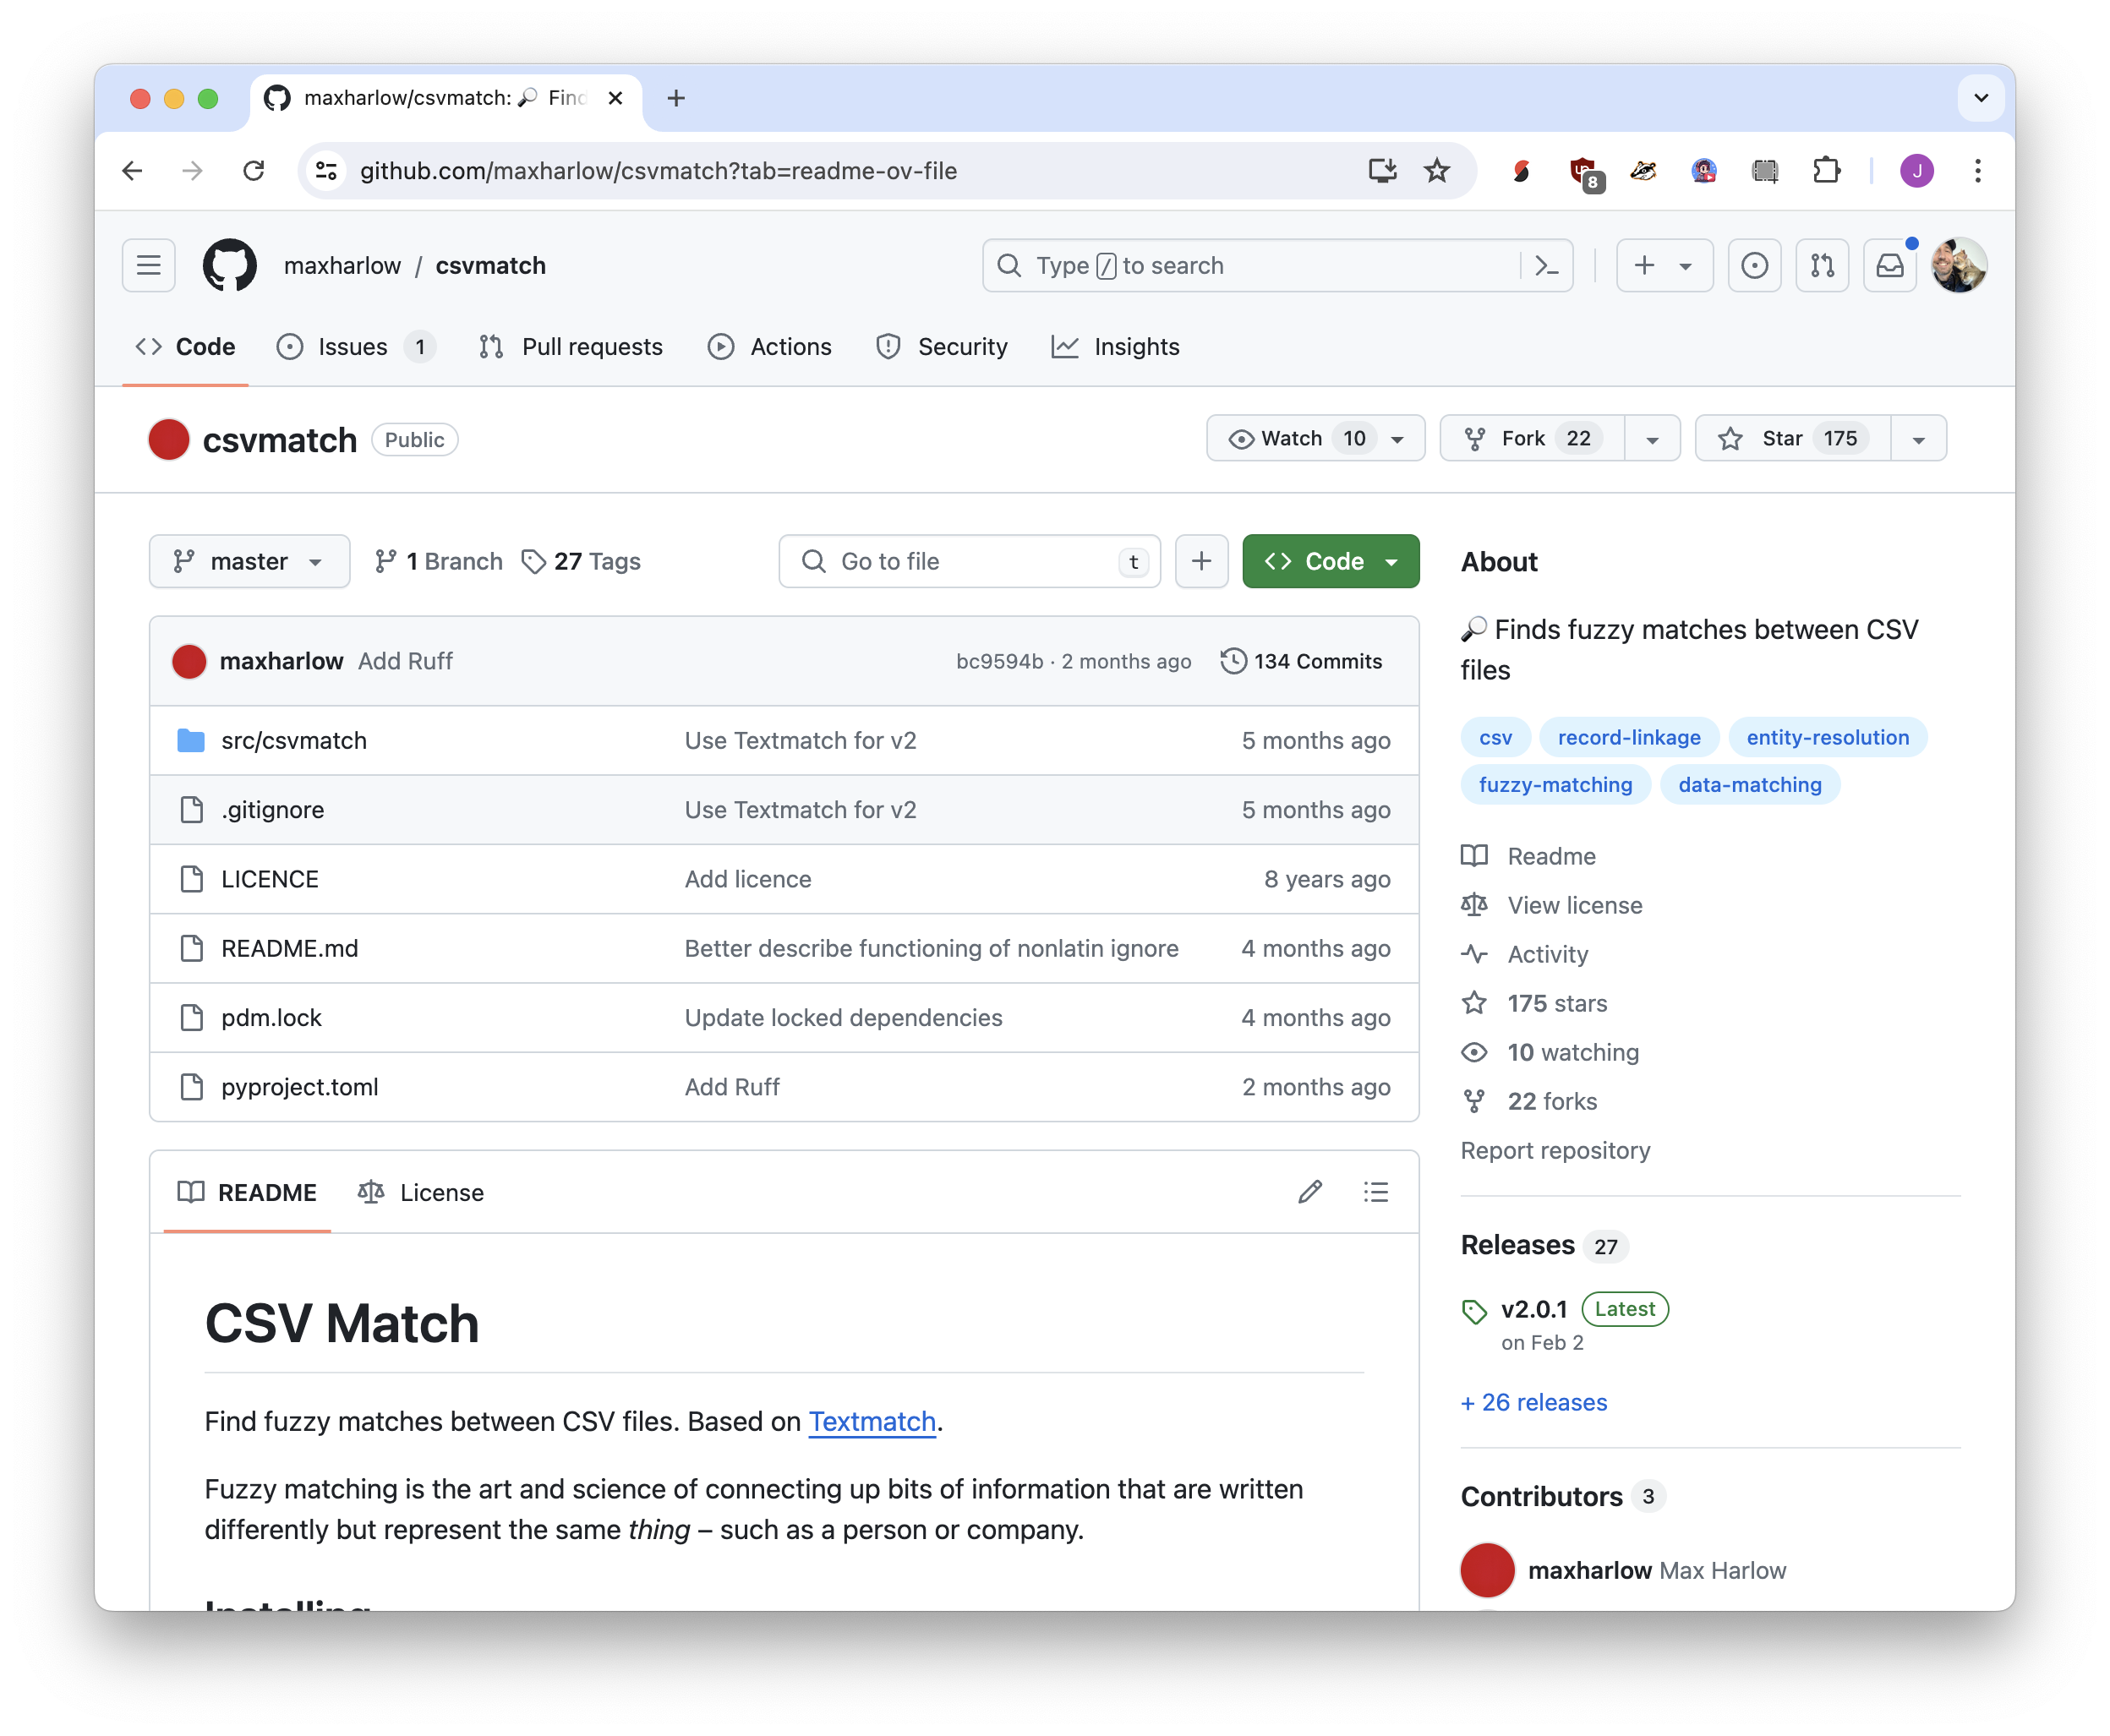
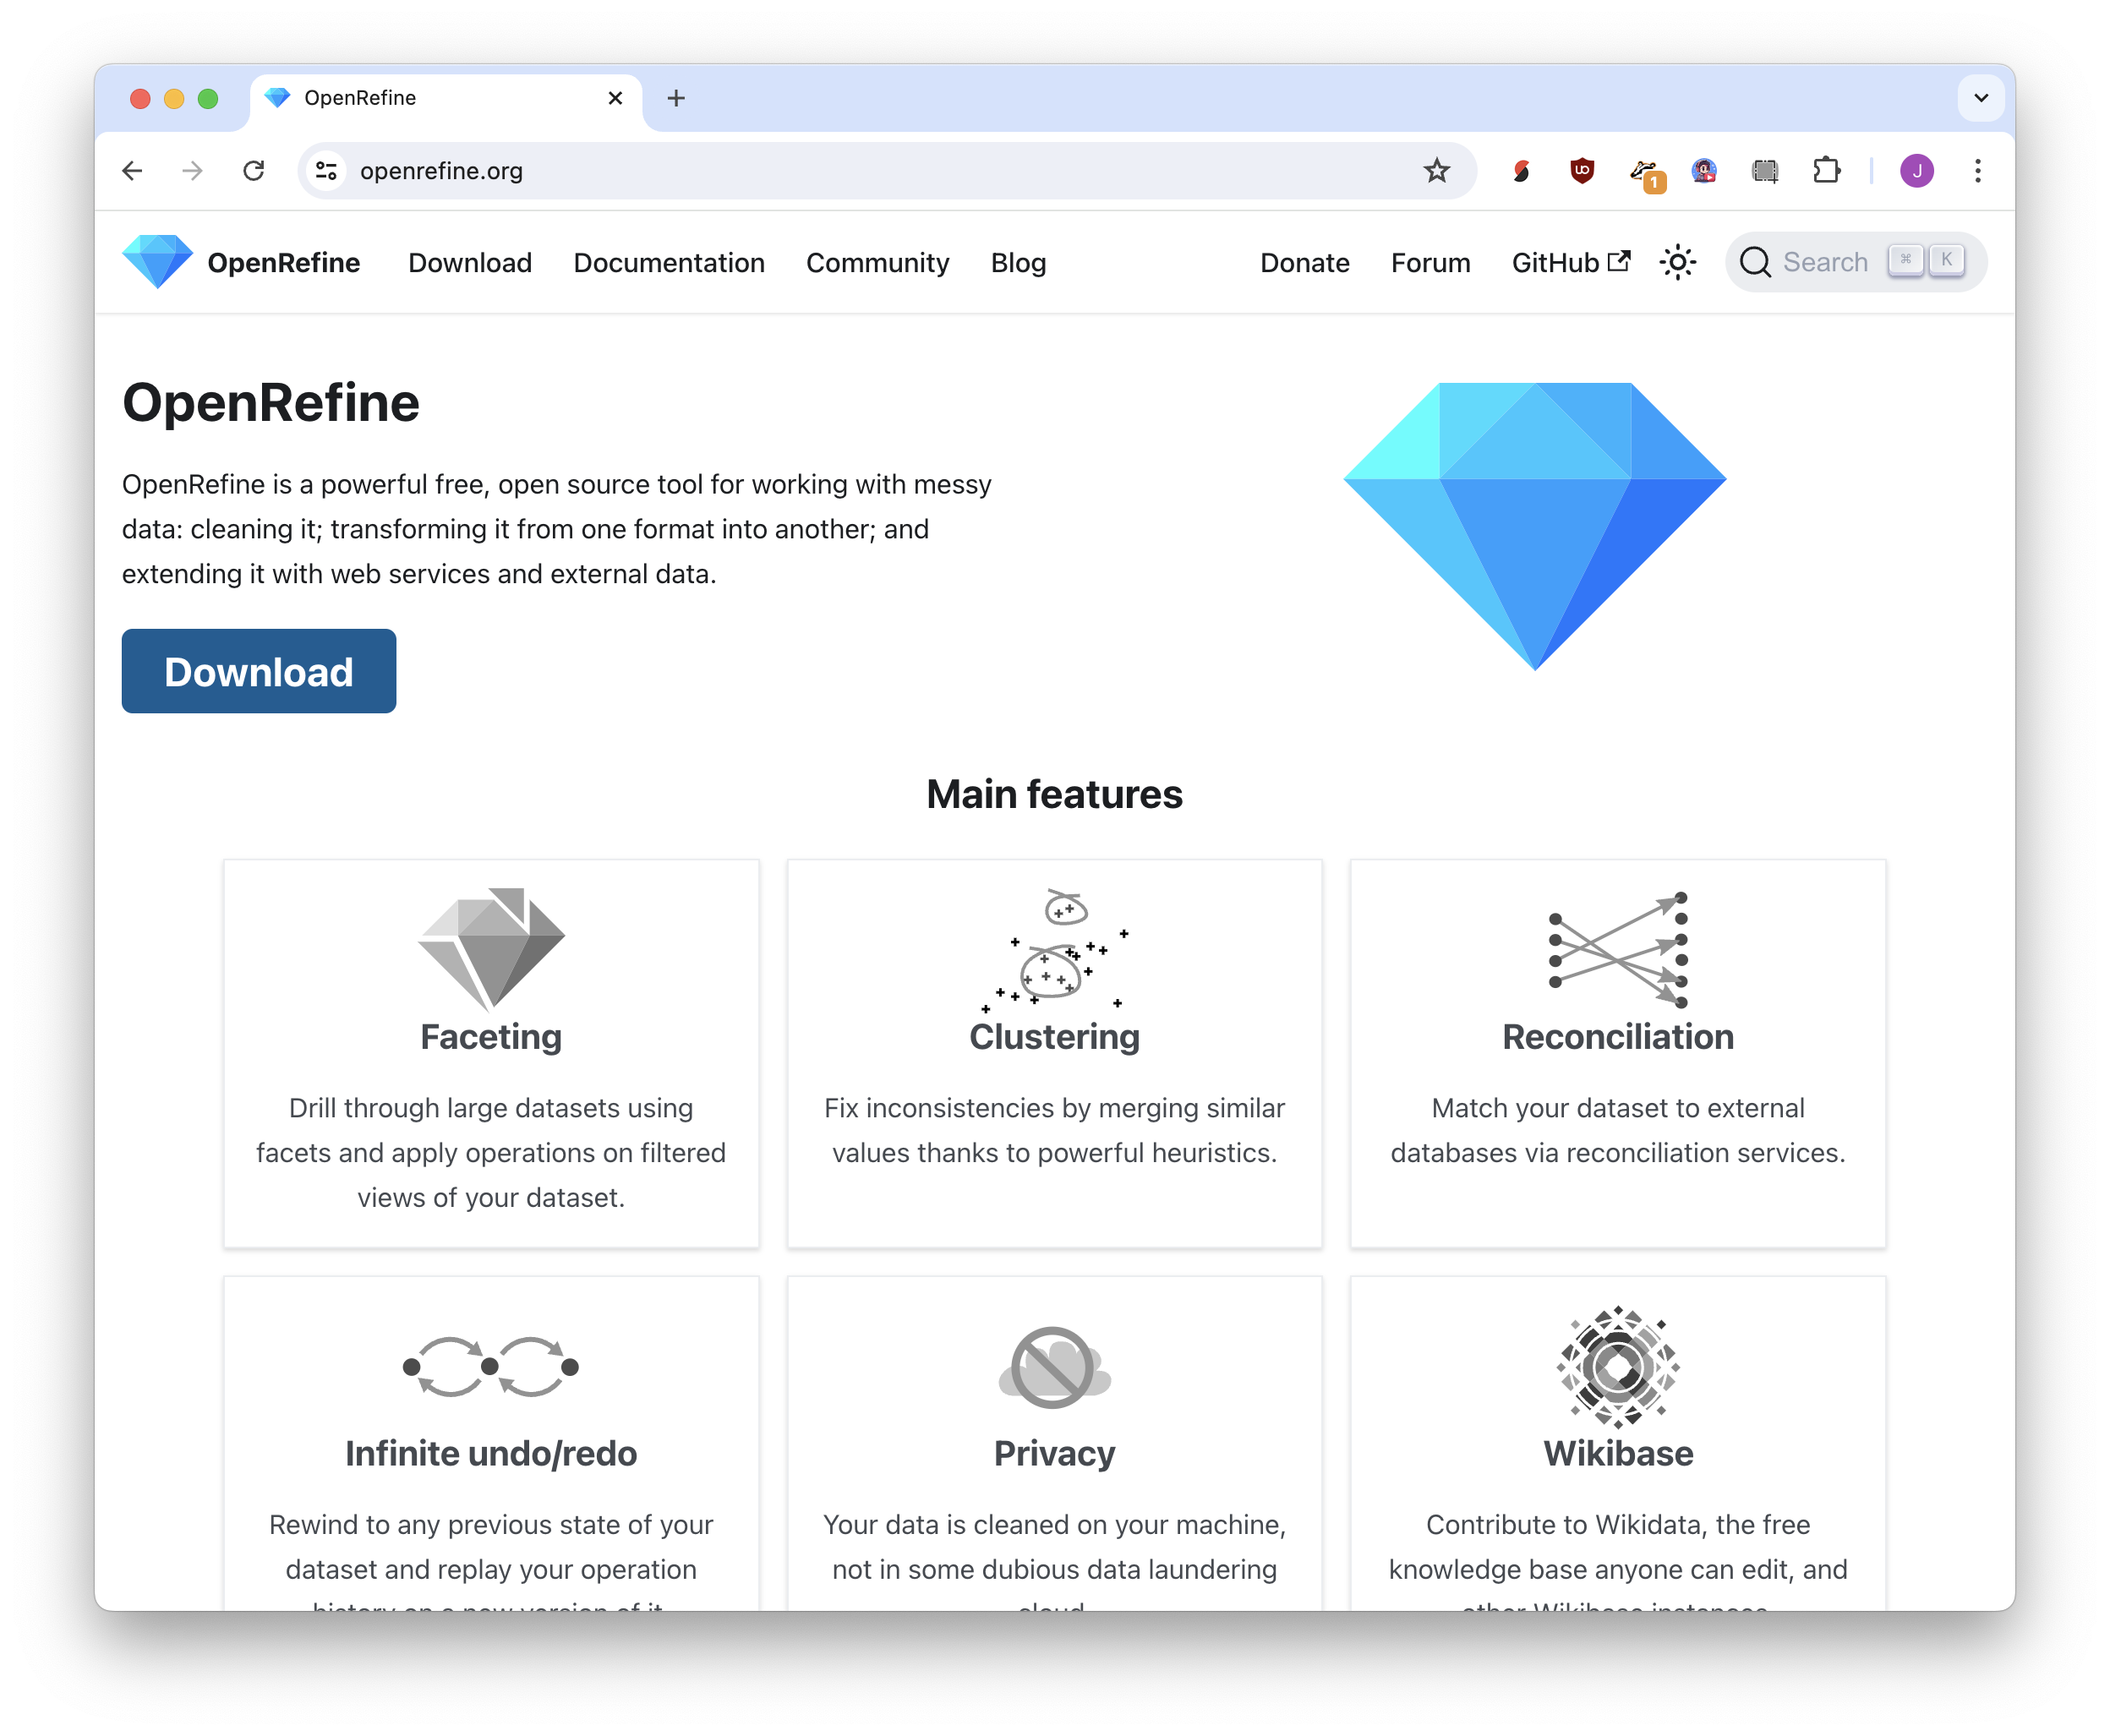




Jonathan Soma
tech: csvmatch
Jonathan P. Soma
Jonathan Soma
fuzzy matching
Jon Soma
Soma, Jonathan
no code:
openrefine

Slide 31
Addresses and maps

Slide 32
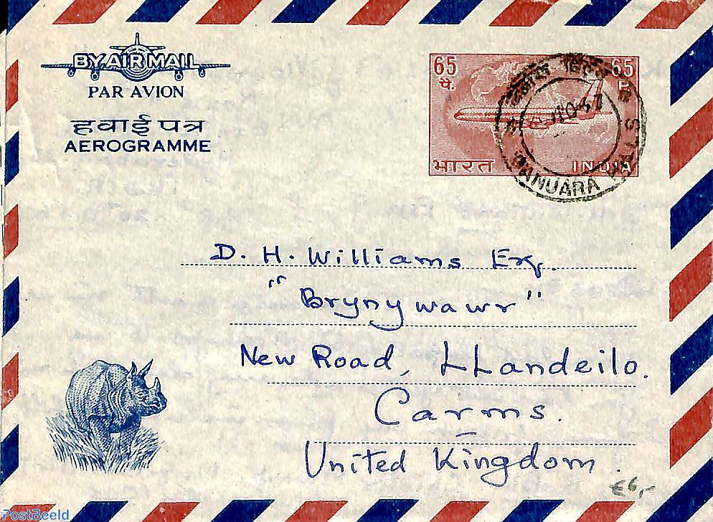



Geocoding
Latitude/Longitude
Plain address
Reverse geocoding

Slide 33
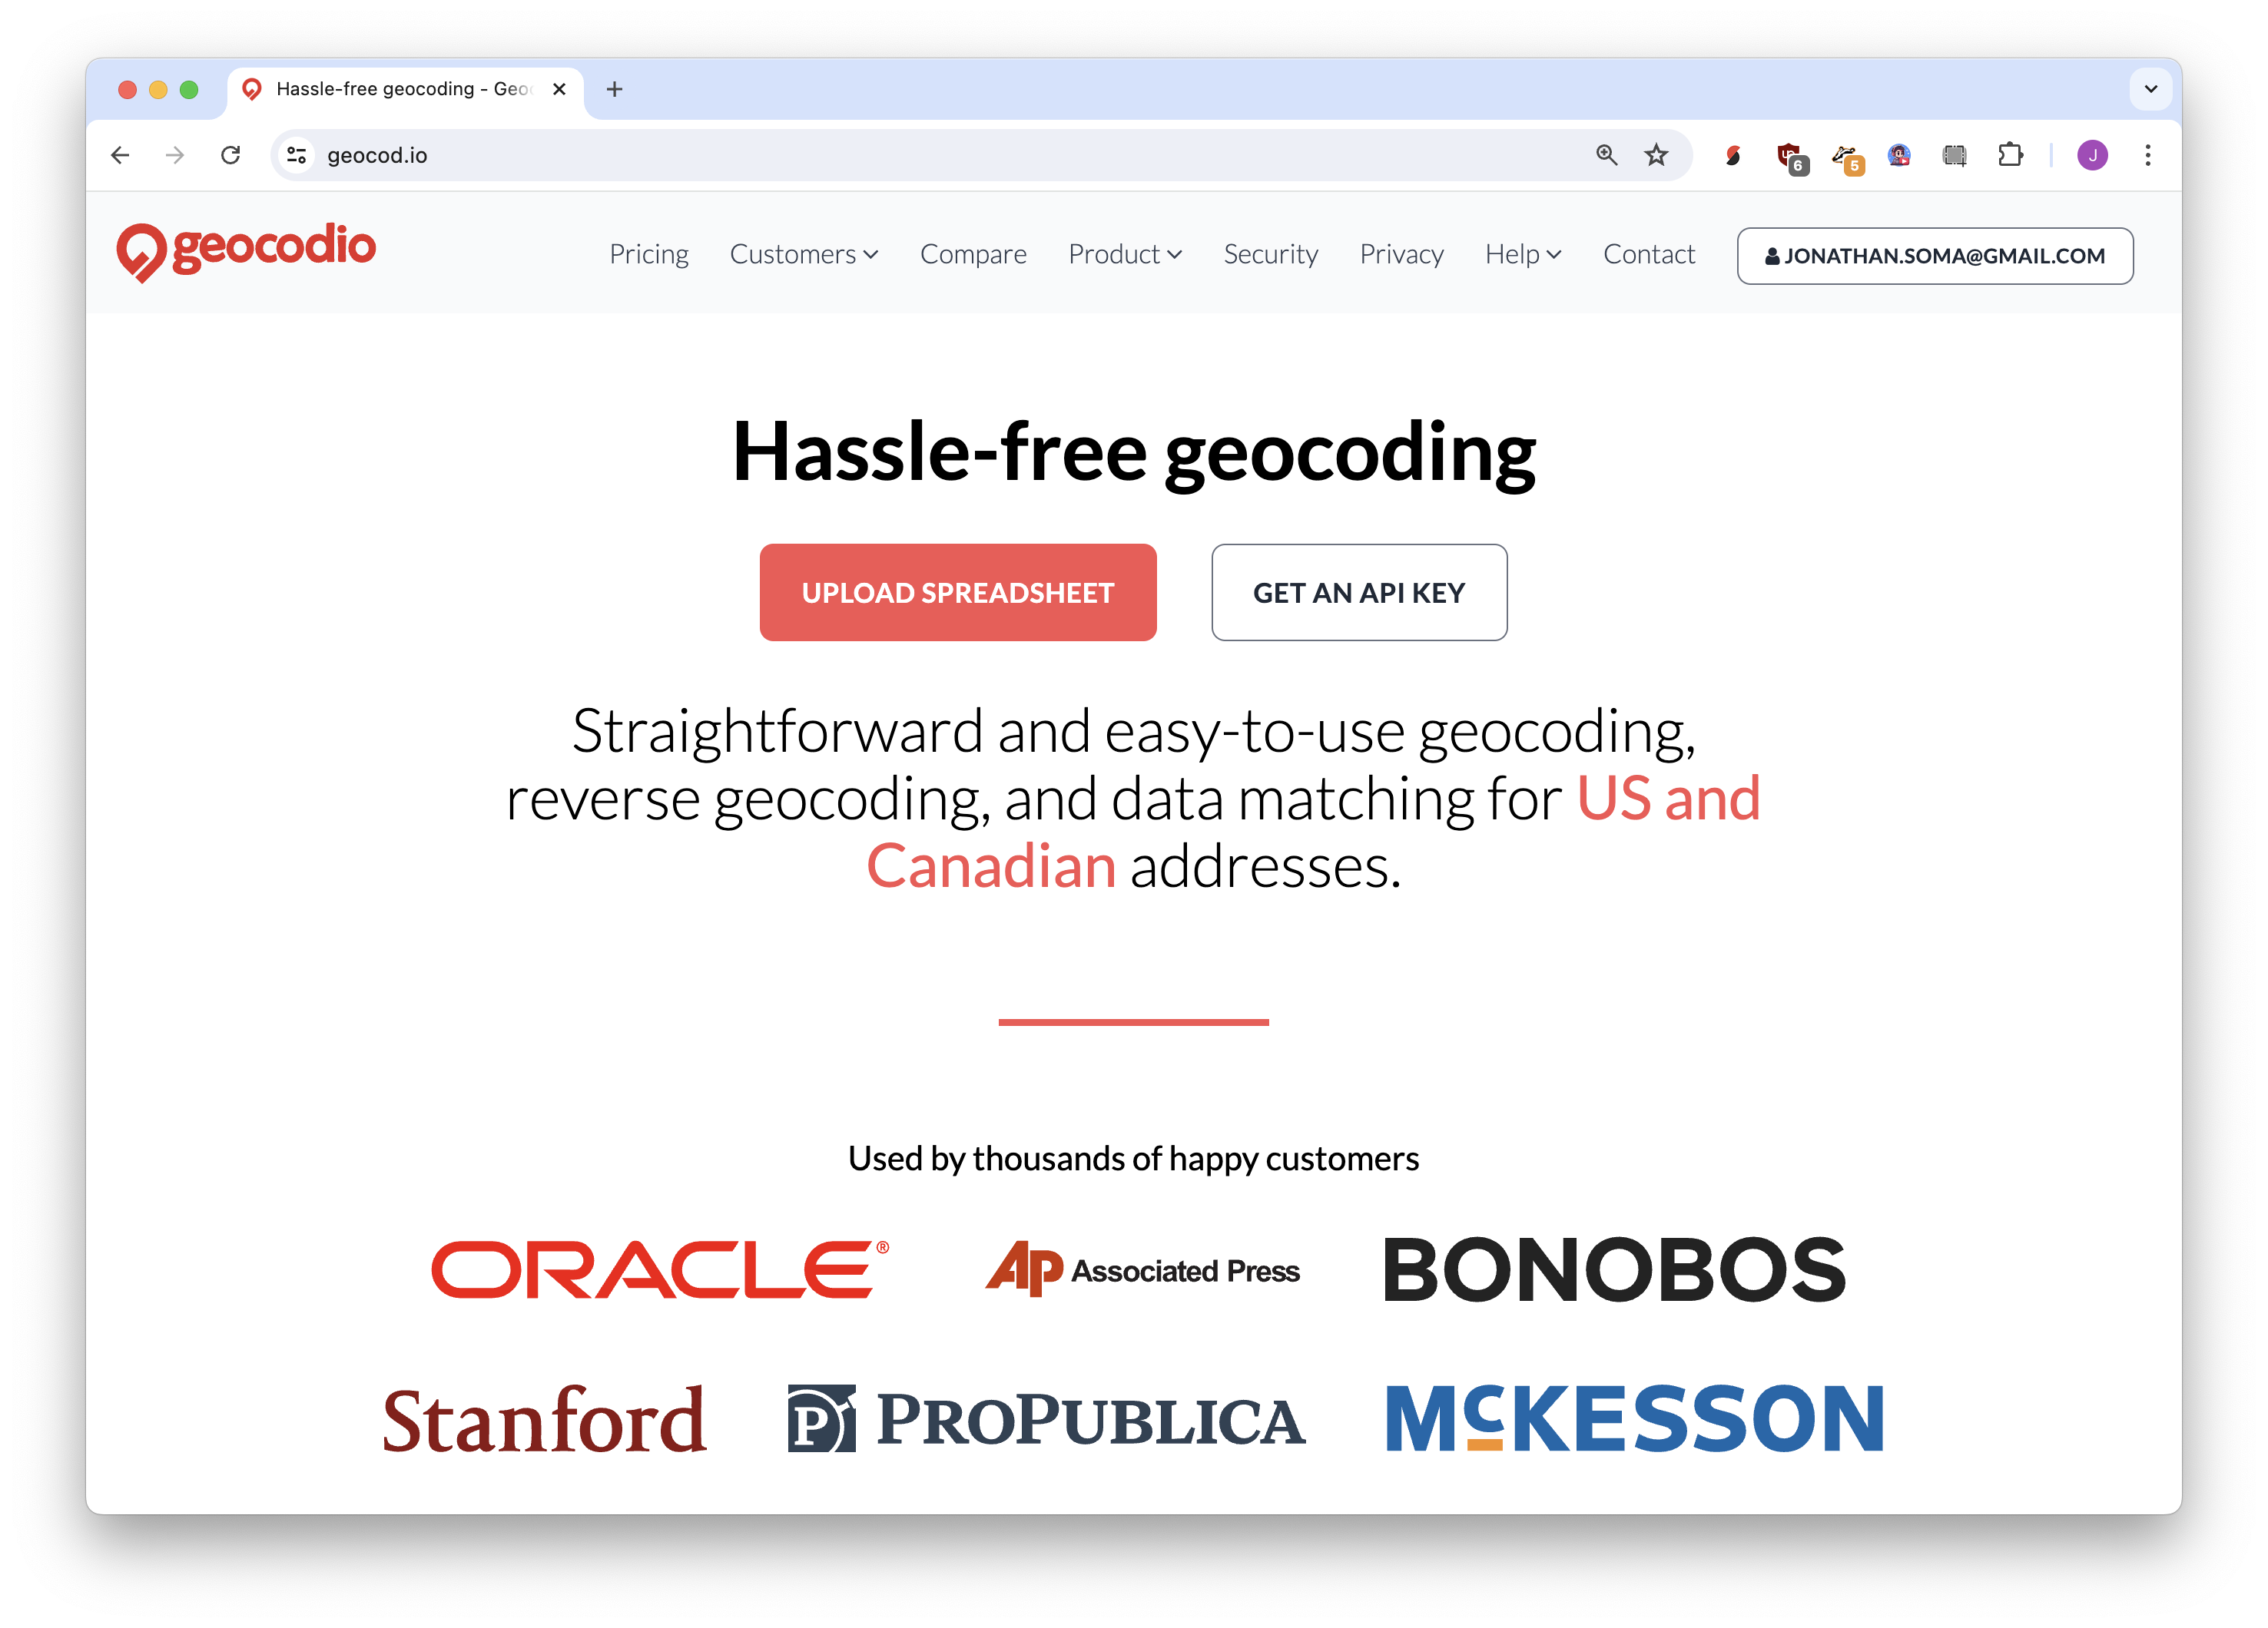
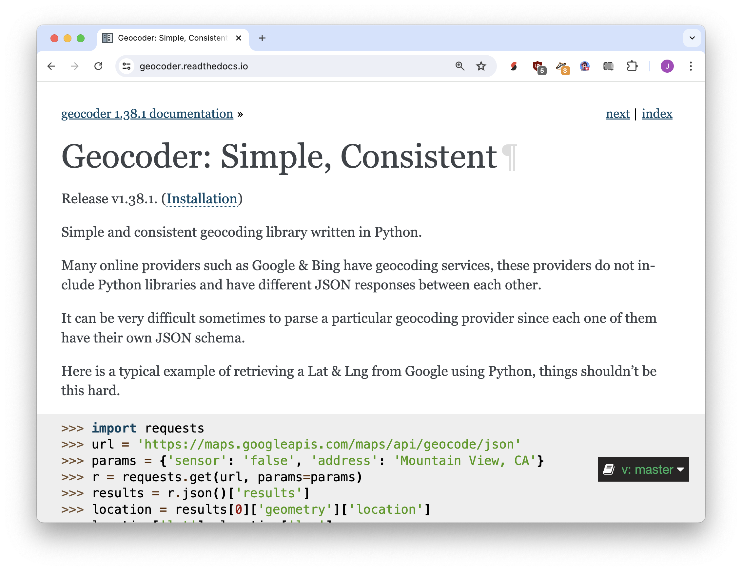
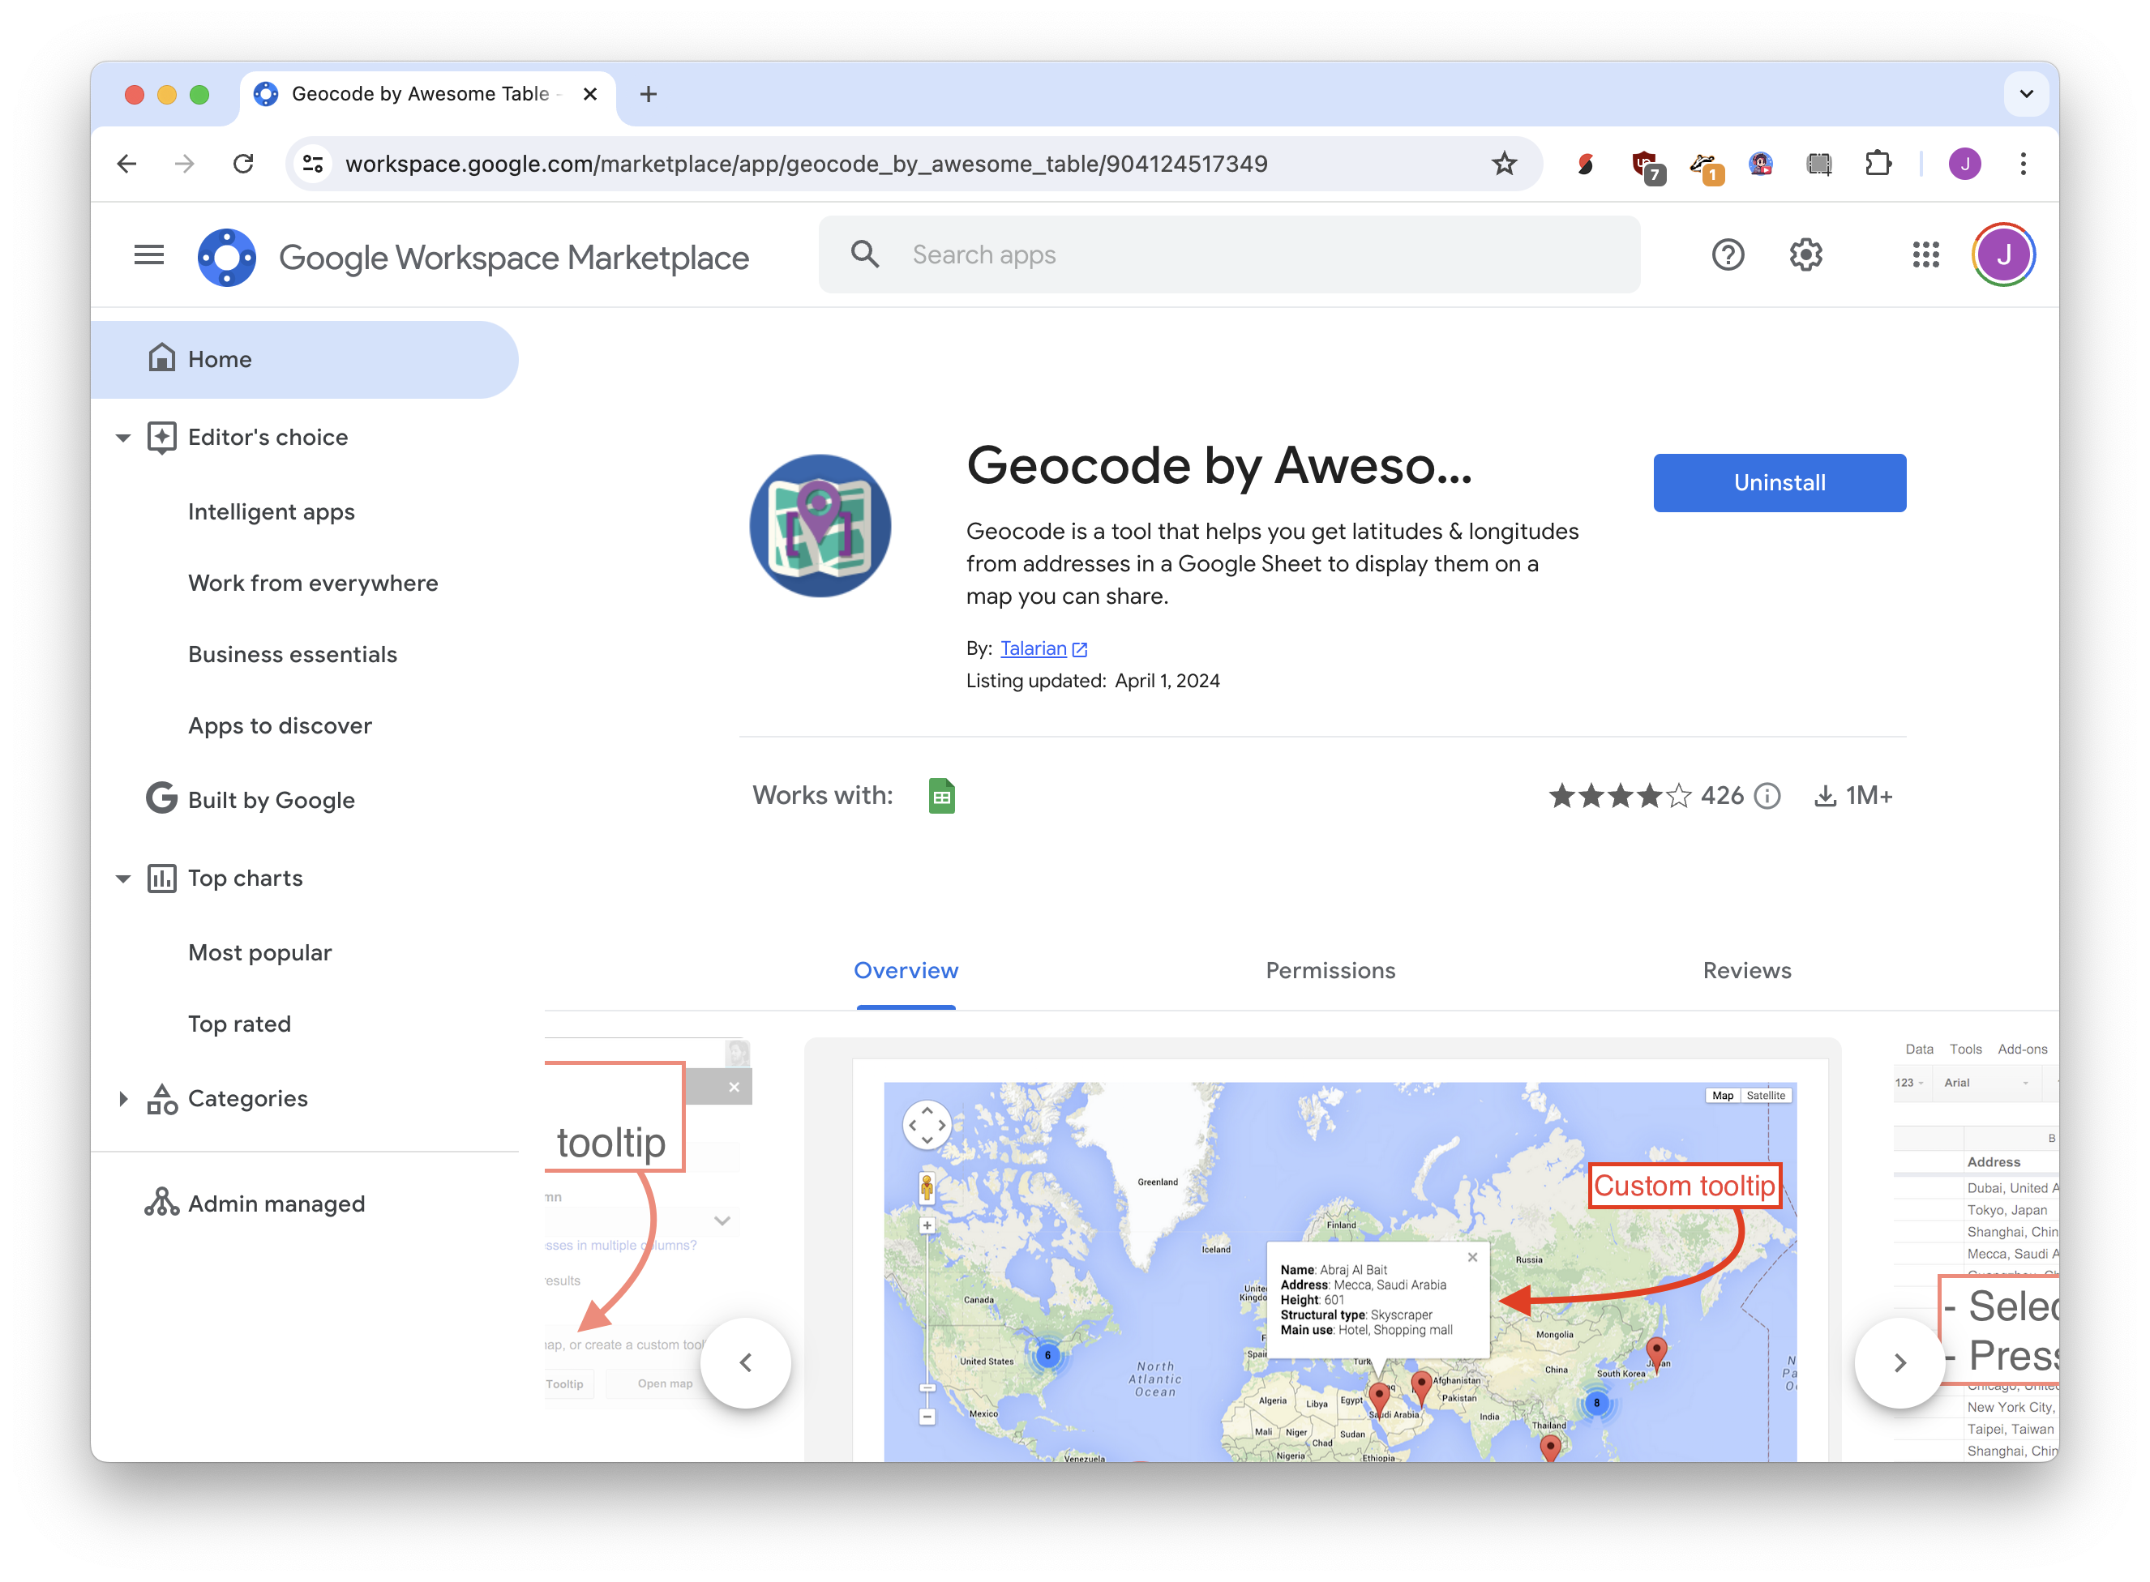
drag and drop: geocod.io
python: geocoder
sheets: geocode by awesome table

Slide 34
Table formatting

Slide 35
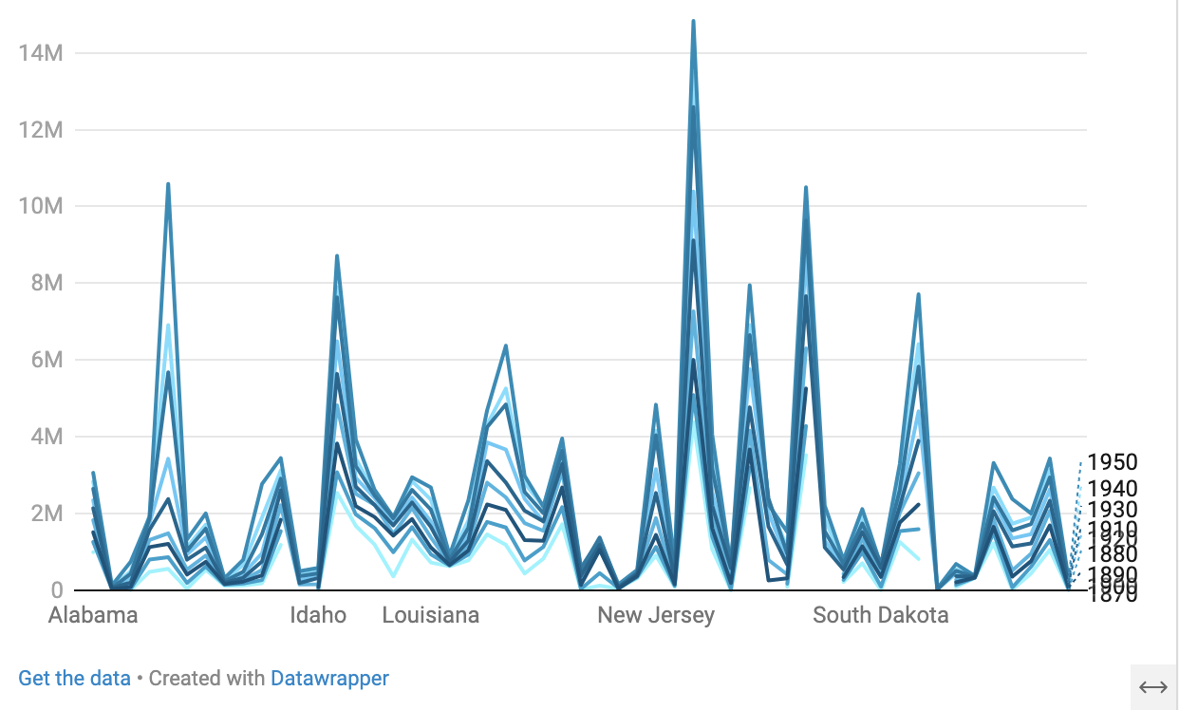





Slide 36
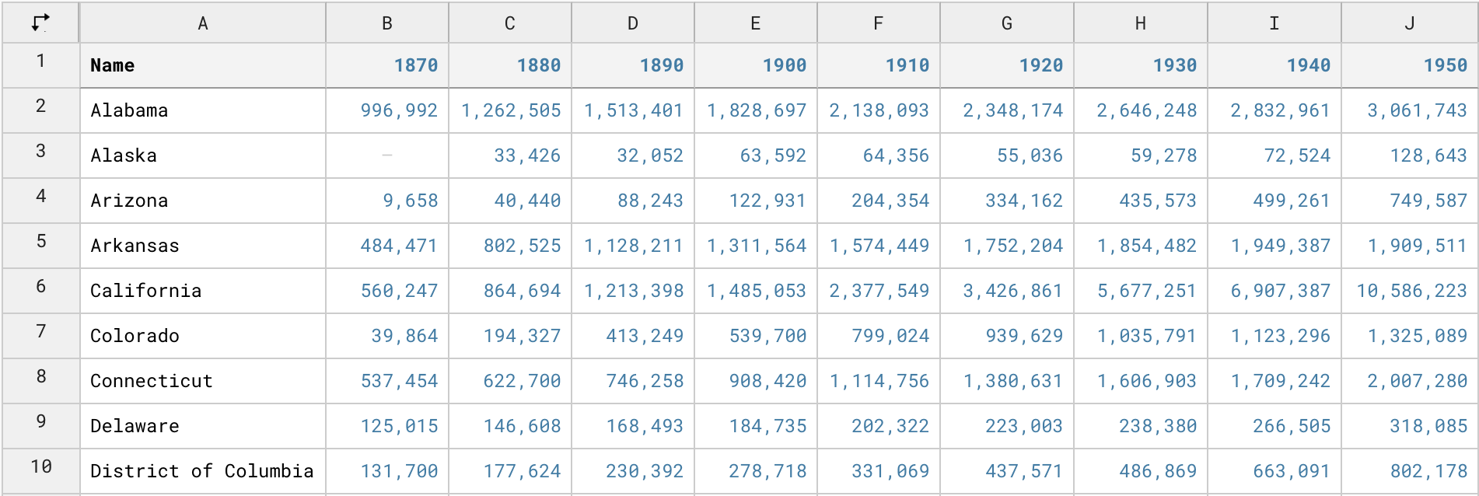
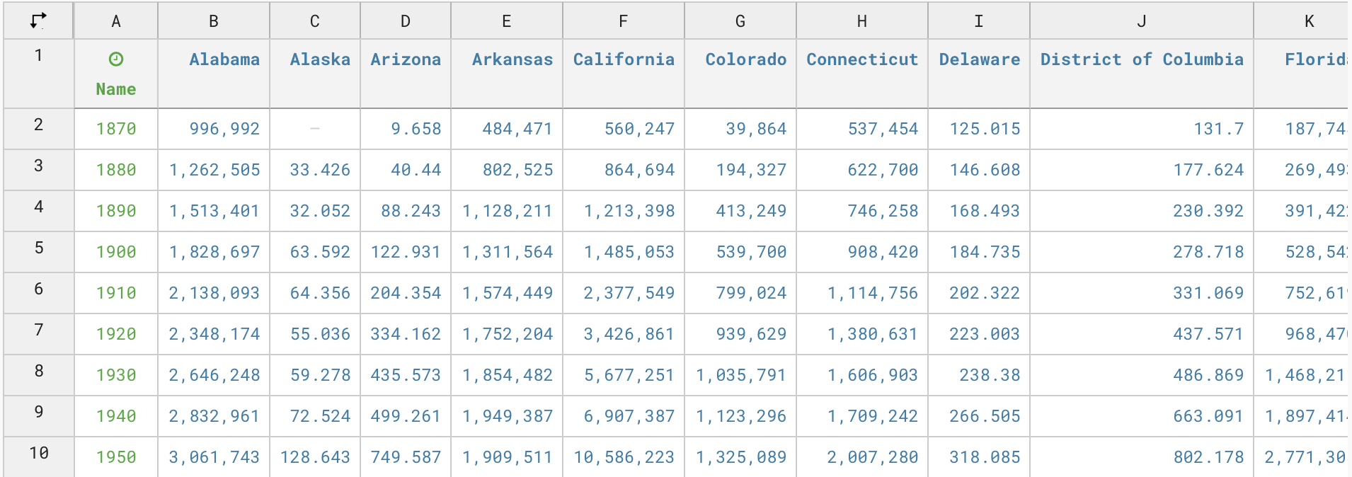


transpose
(swap rows/columns)

Slide 37
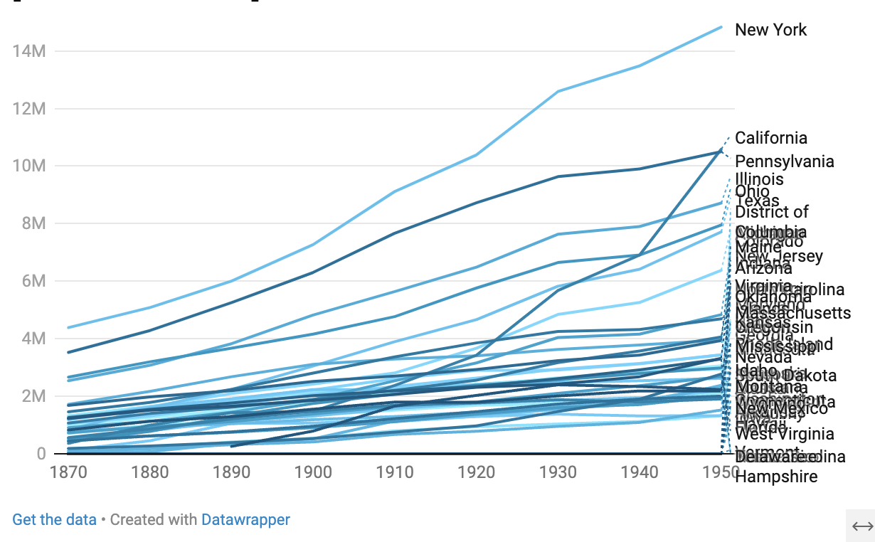





Slide 38
Transcribing audio

Slide 39
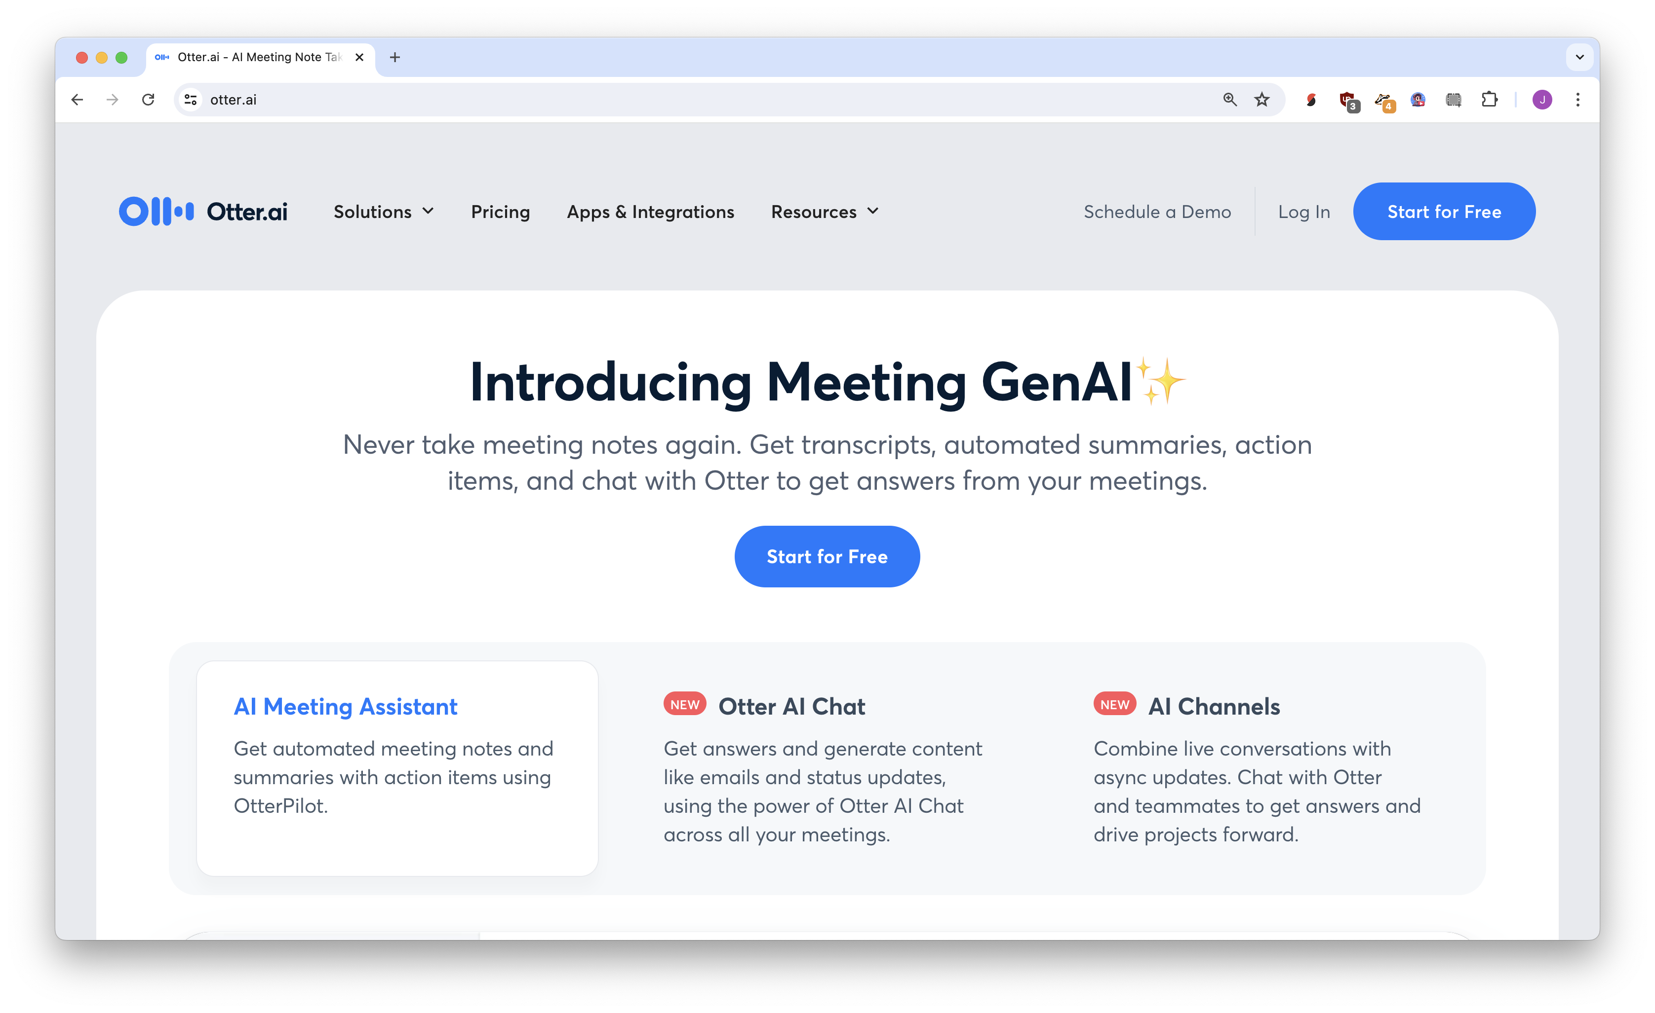







Slide 40
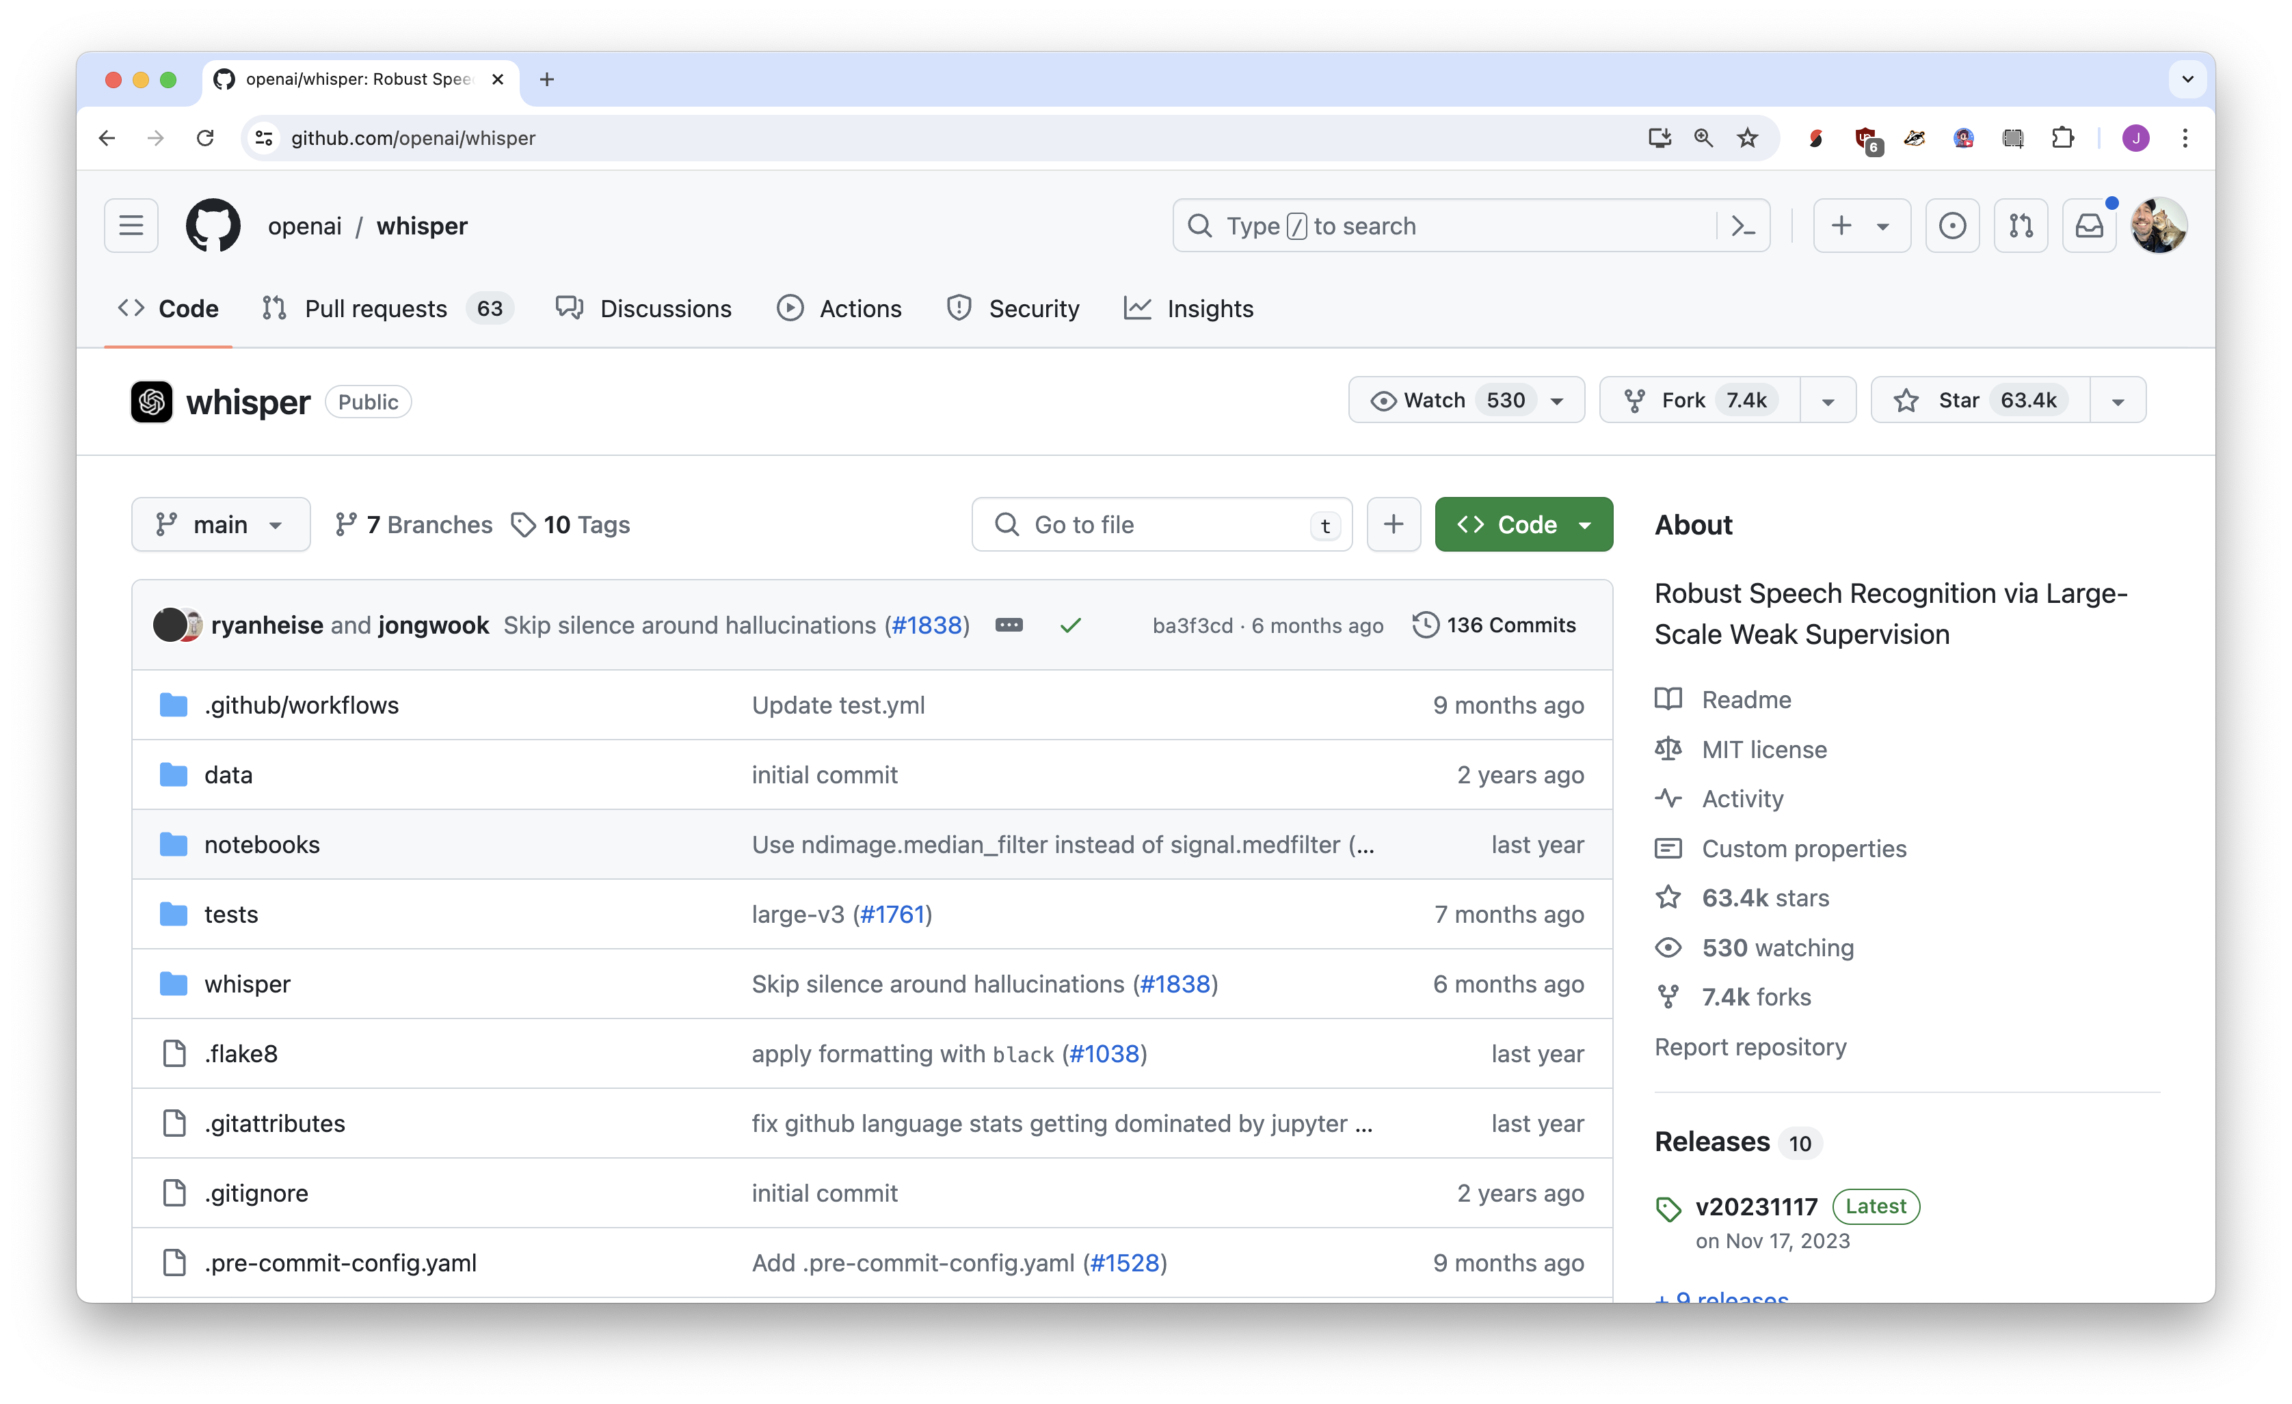
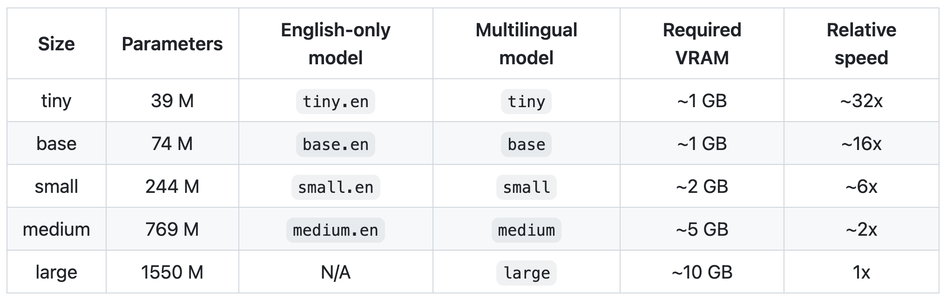
magic technology: OpenAI’s Whisper

Slide 41
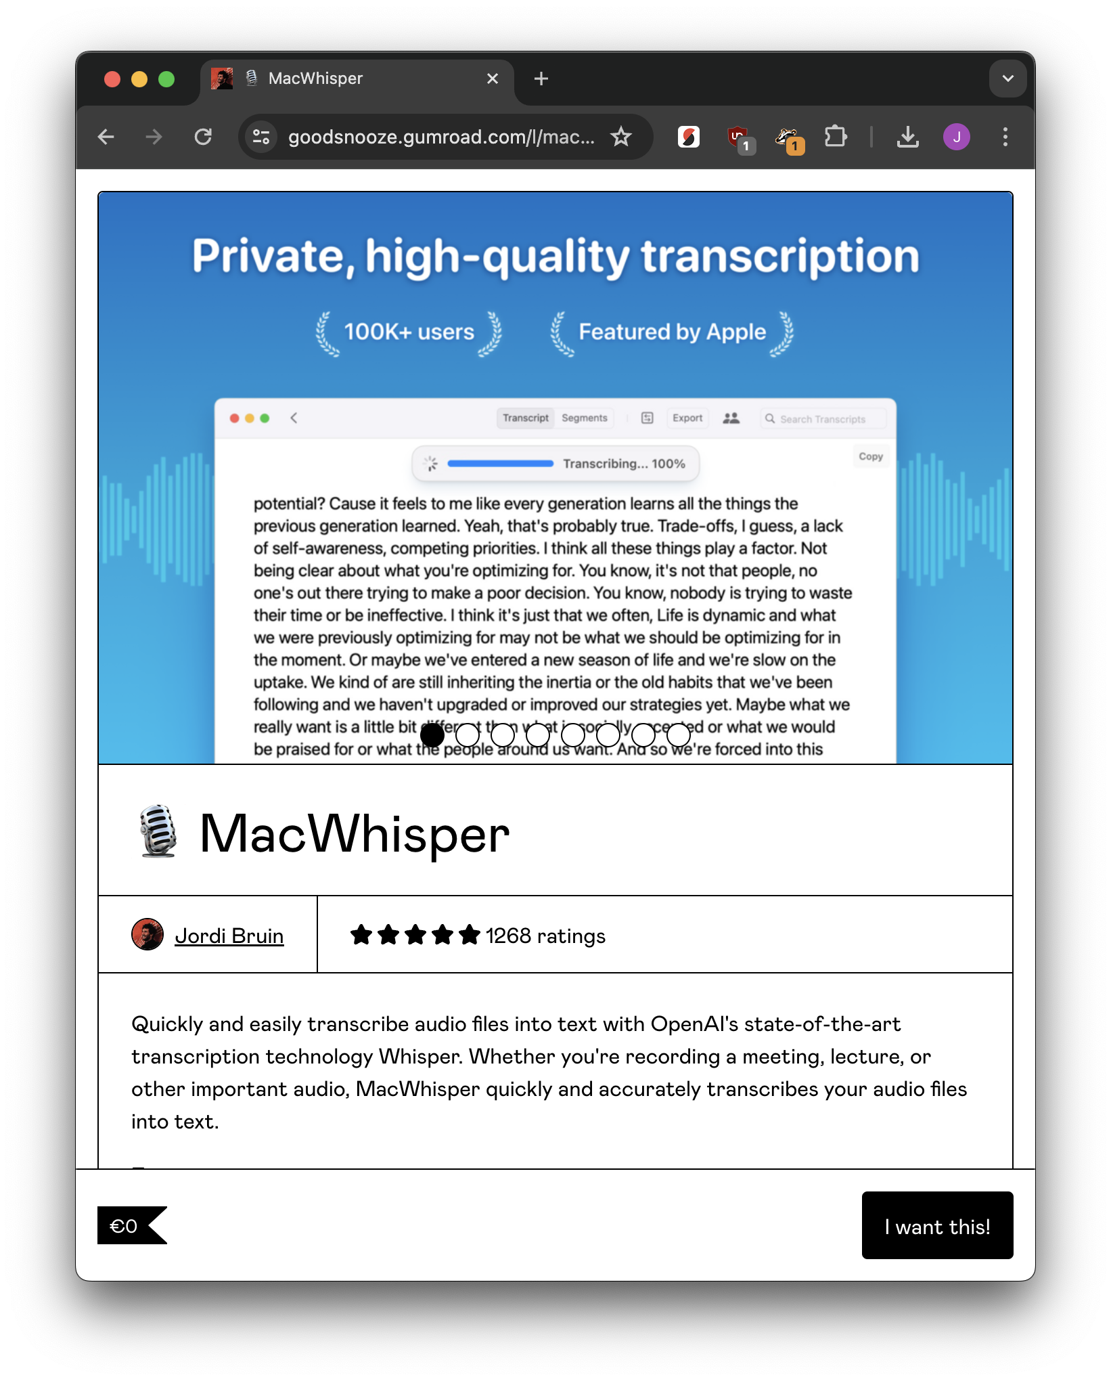
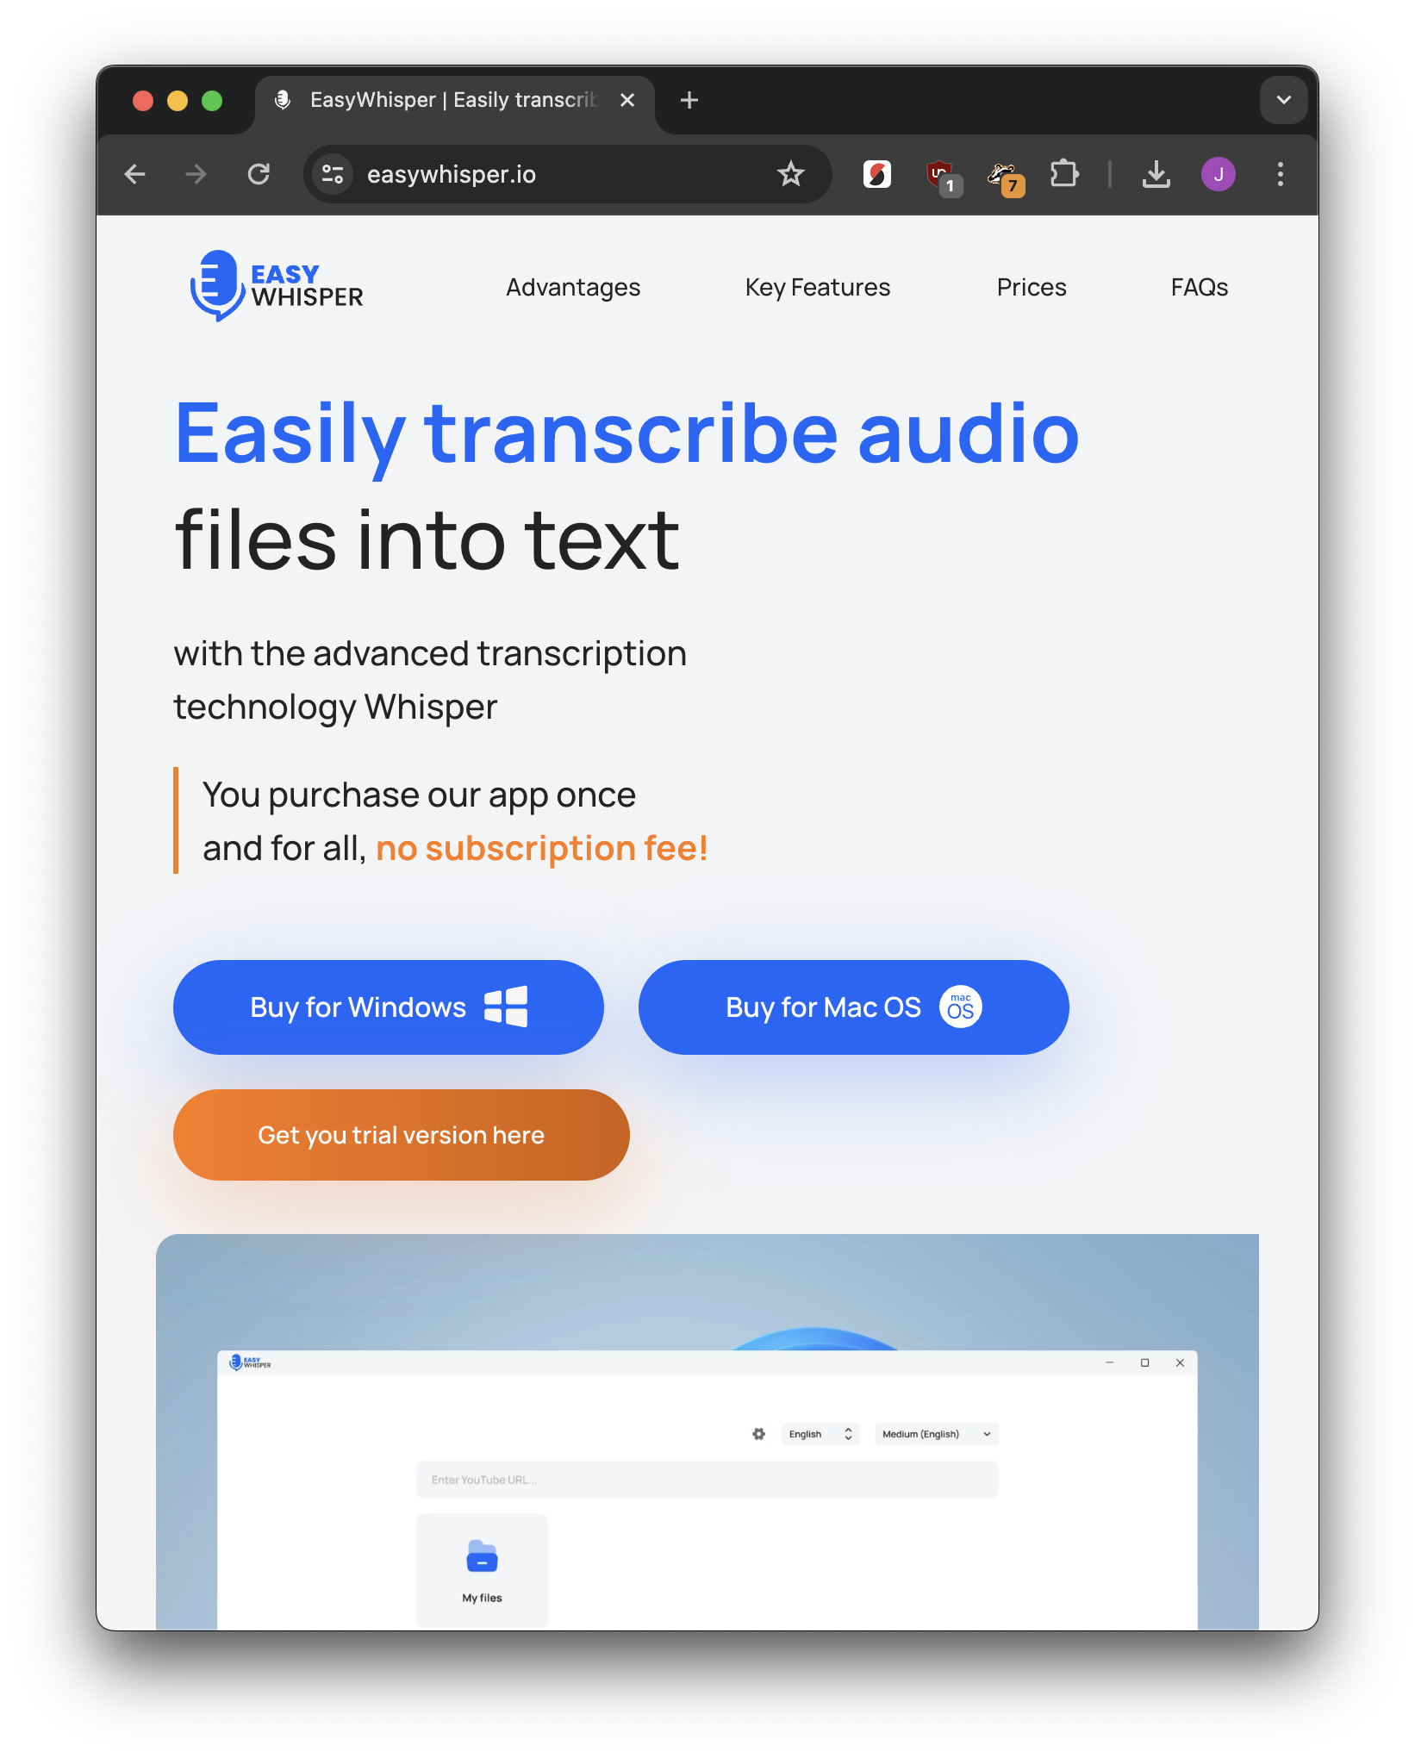
macOS: MacWhisper
Windows: EasyWhisper

Slide 42
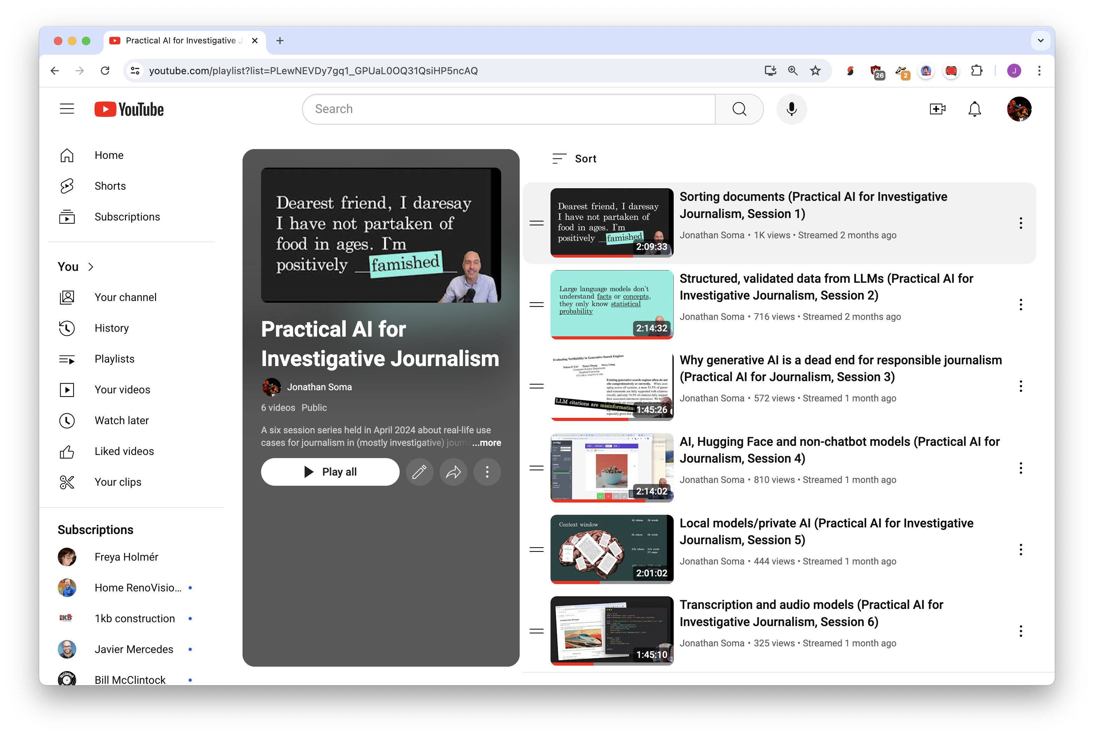



Slide 43
Generating structured data with the awful power of LLMs

Slide 44



FROM: Mulberry Peppertown (mulbs@example.com)
When I pick up the cans of beans they are all so light! At first I thought they were empty, but it turns out they are just futuristic beans that are not heavy like the old style beans I was used to. It is incredible.
Mulberry Peppertown
name
mulbs@example.com
email
beans
food item

Slide 45
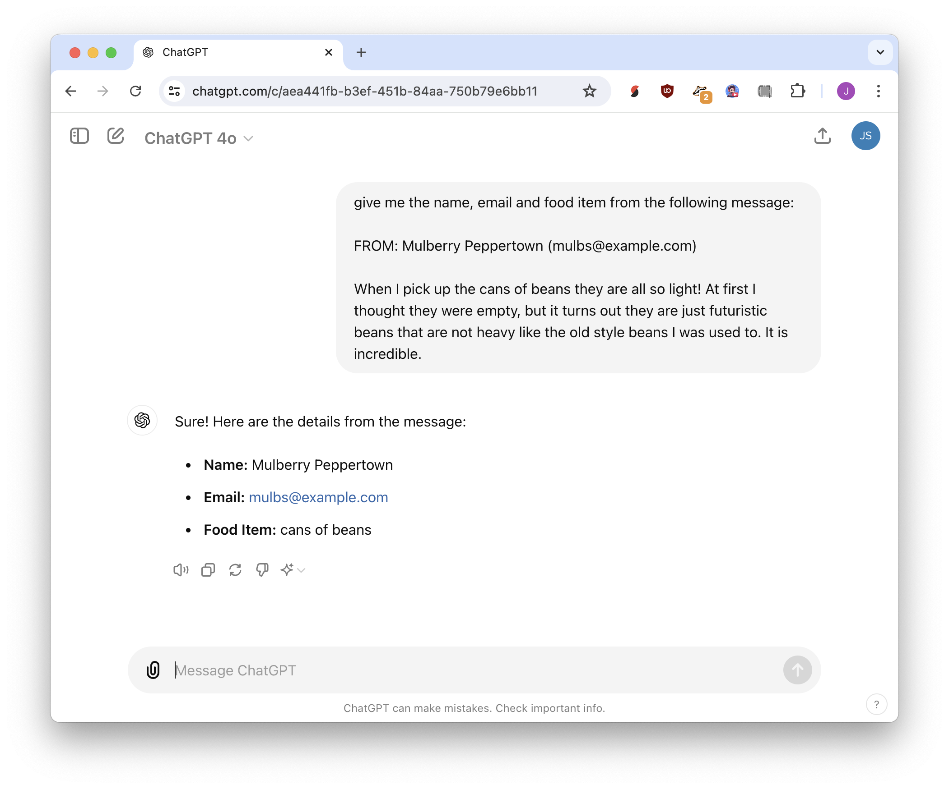

Slide 46
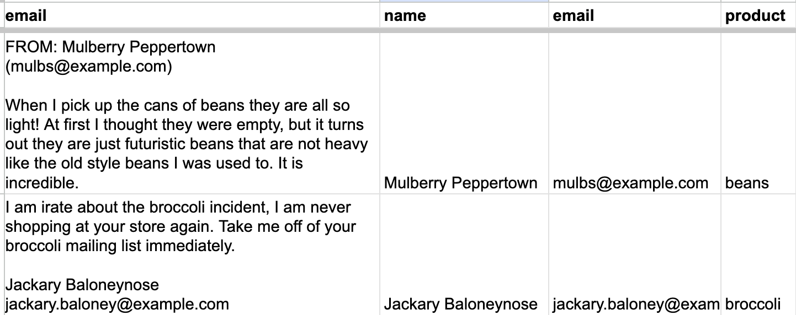
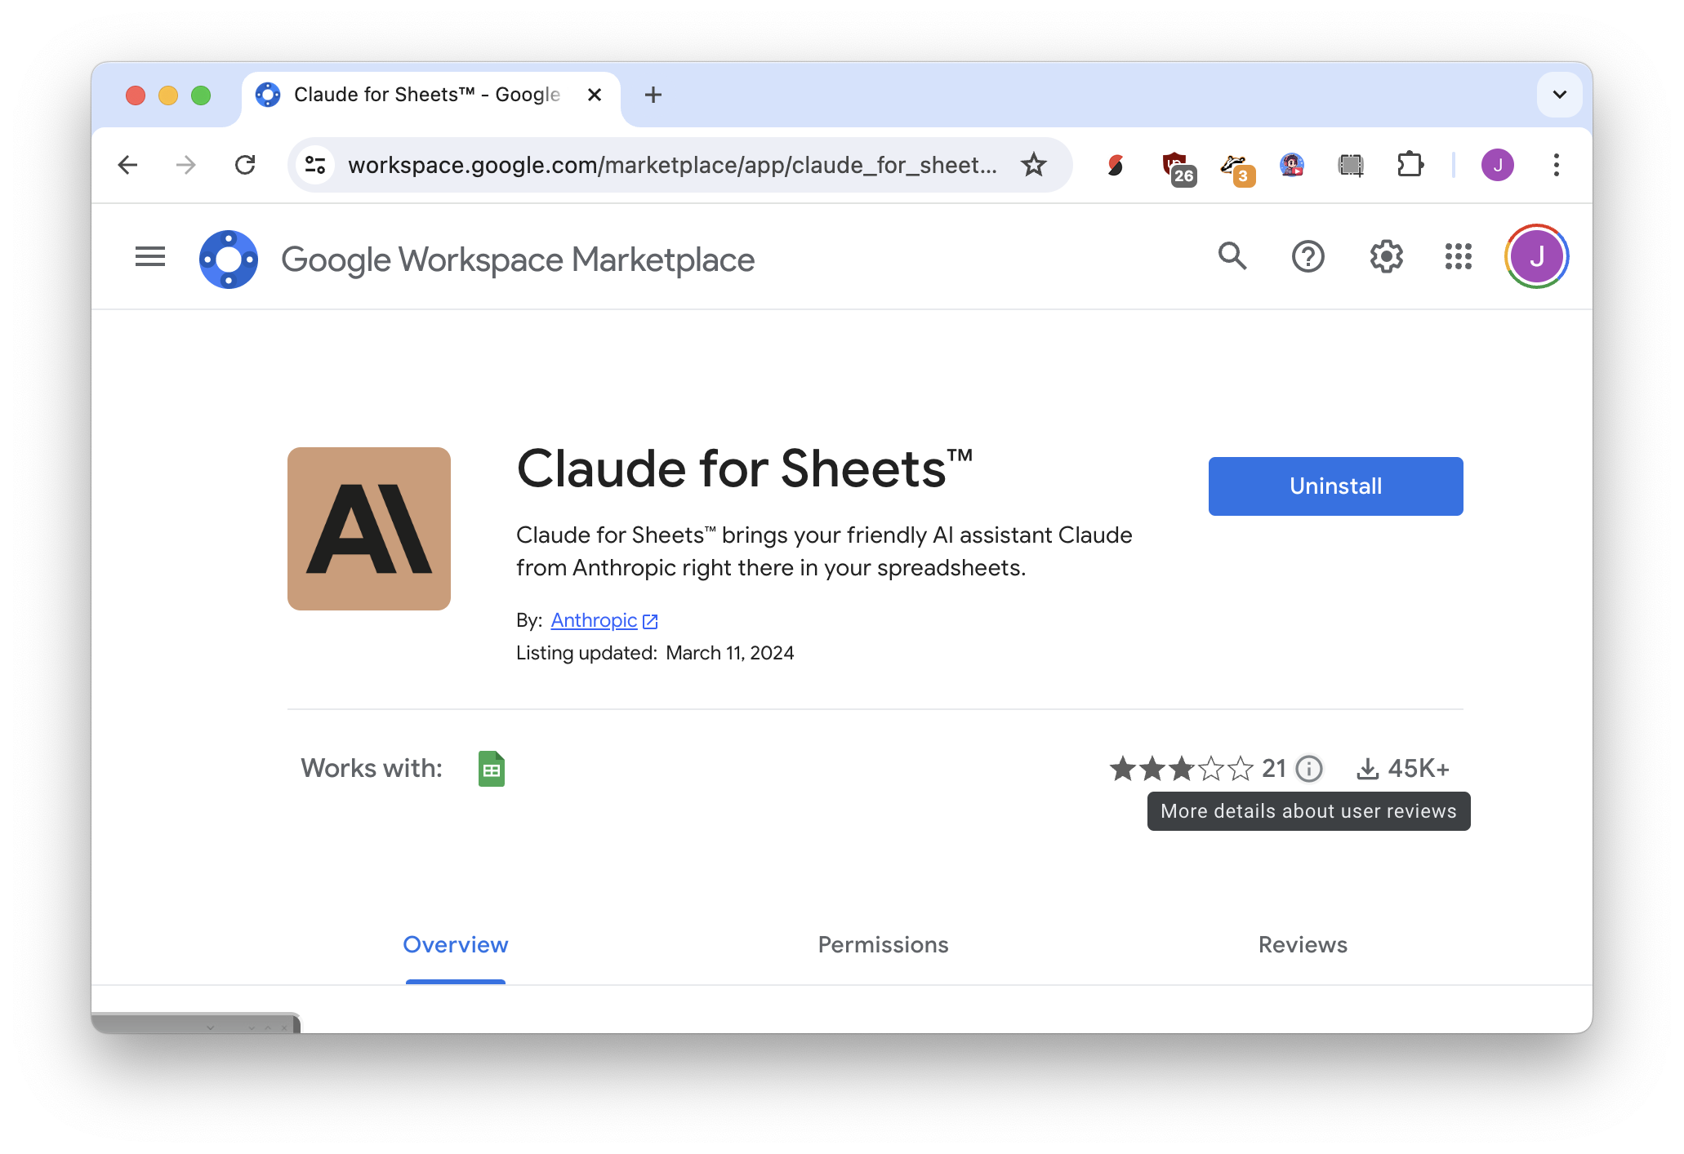
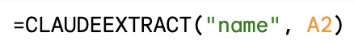
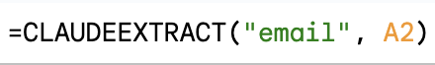
Sheets: Claude for Sheets

Slide 47
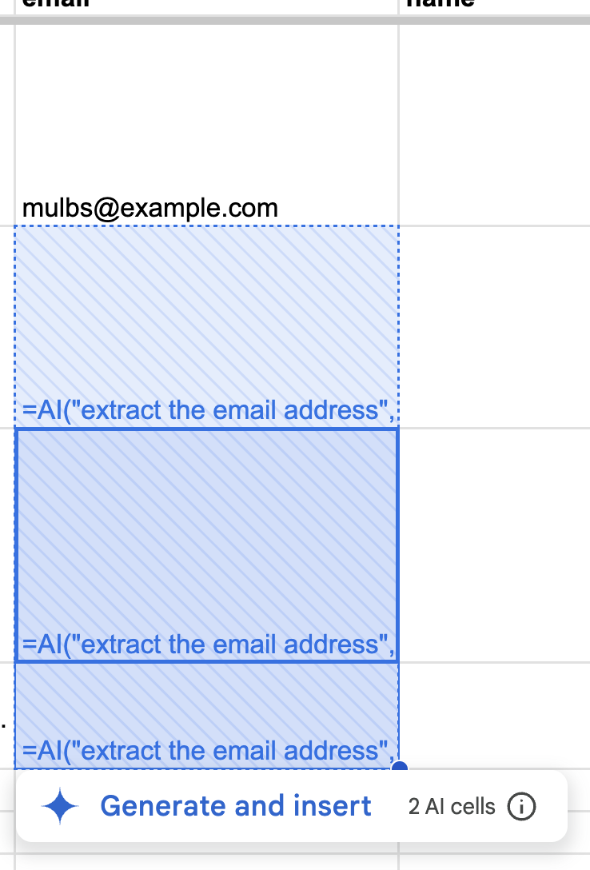
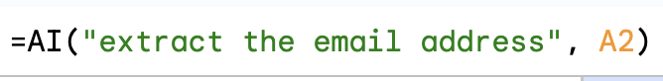
Sheets: Gemini in Google Sheets

Slide 48
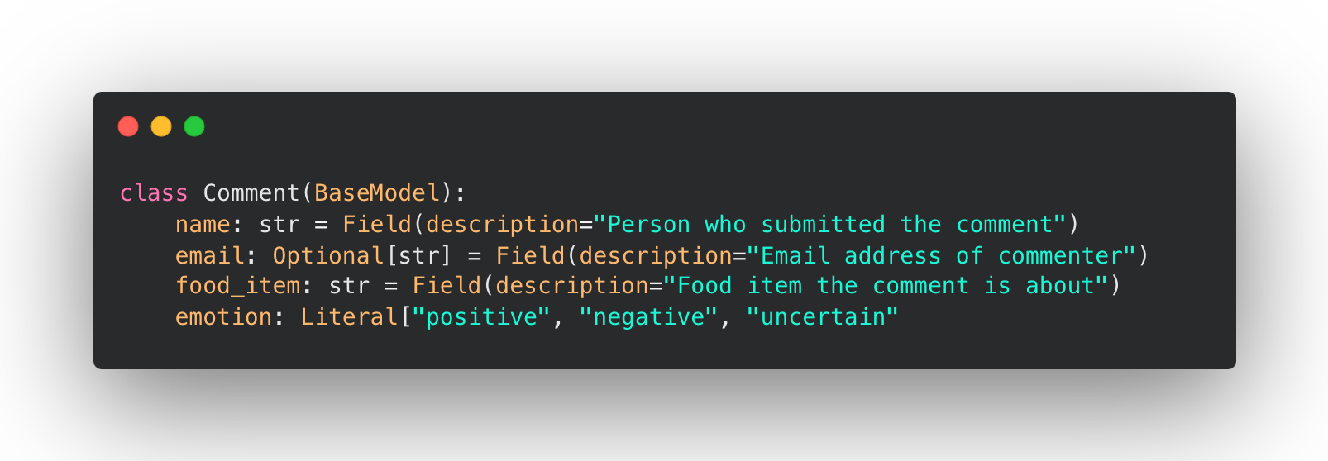
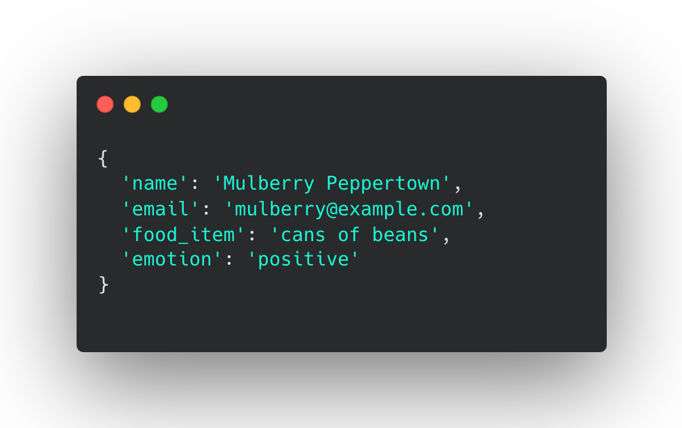
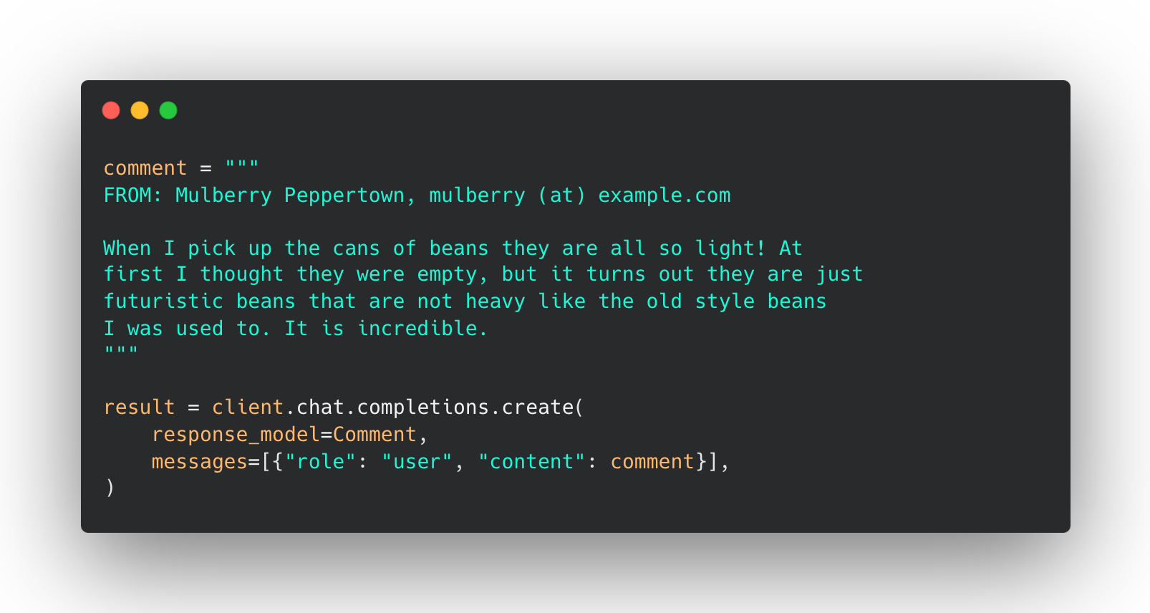









Python: Structured Outputs

Slide 49
Visit bit.ly/ire25-cleaning
Time for exercises!!
jonathansoma.com/everything
Jonathan Soma
Knight Chair in Data Journalism
Columbia Journalism School
js4571@columbia.edu

Slide 50
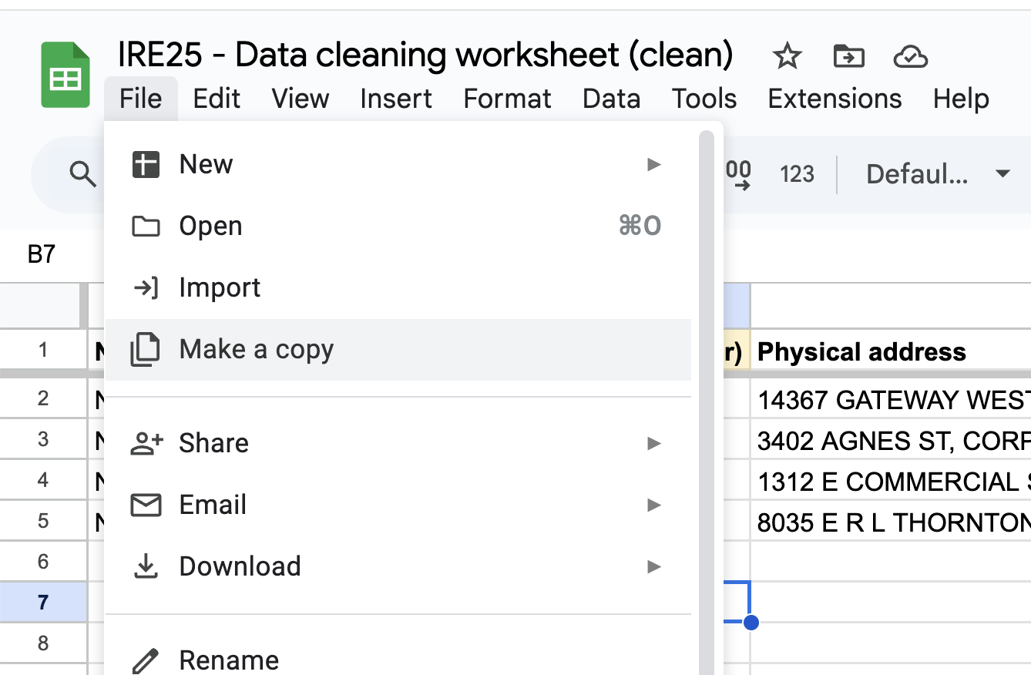
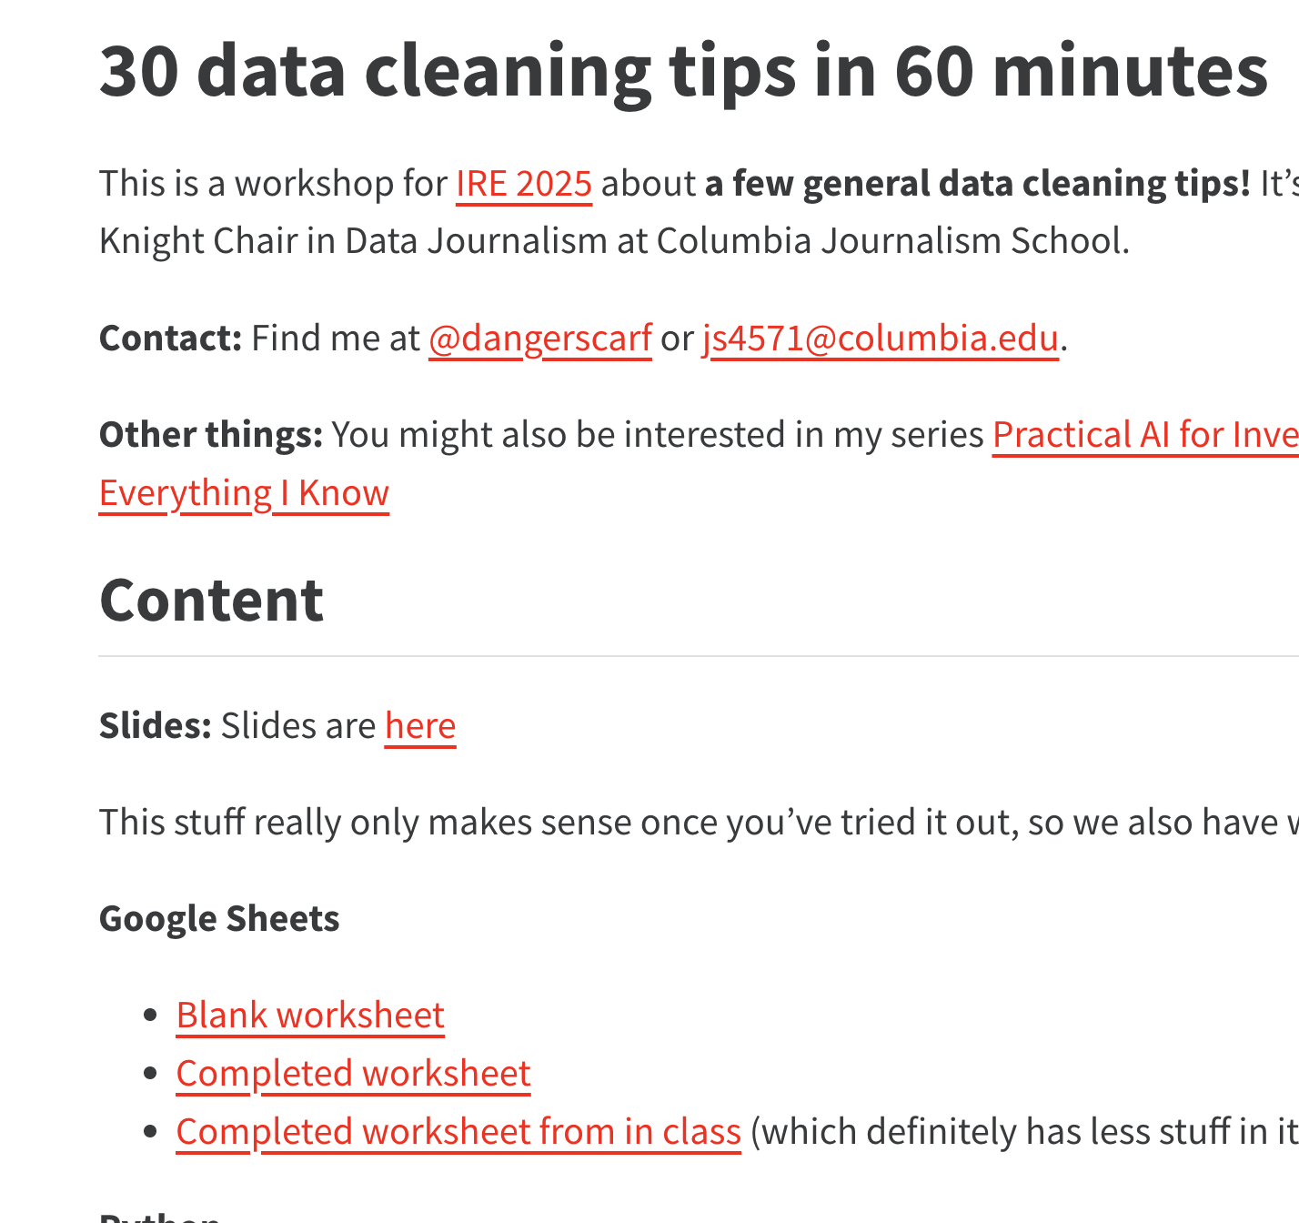



Visit bit.ly/ire25-cleaning
File
Blank worksheet
Make a copy

Slide 51
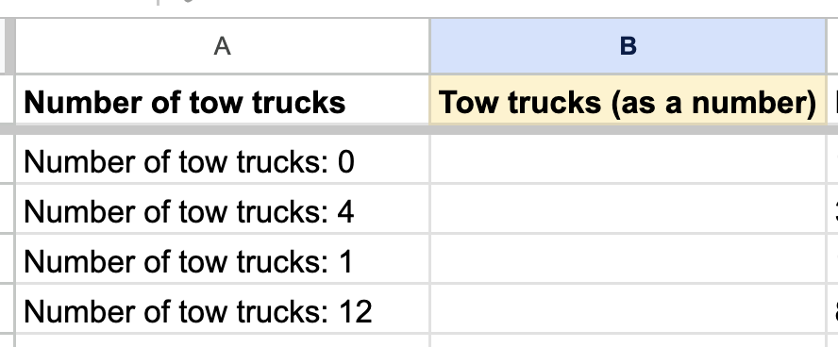
Tab: tow trucks

Slide 52
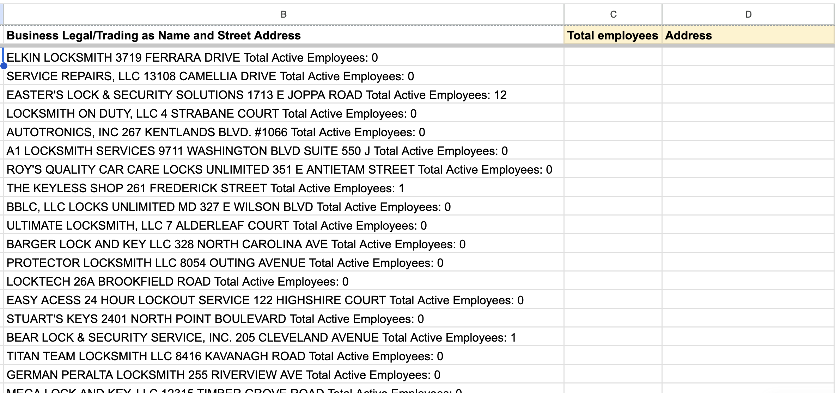
Tab: locksmiths

Slide 53
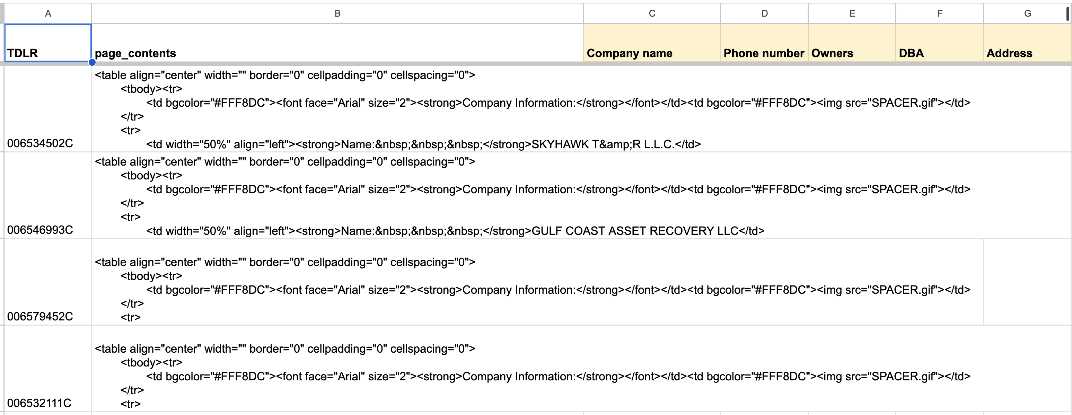
Tab: tow trucks 2

Slide 54
Tab: tow trucks 2

Slide 55
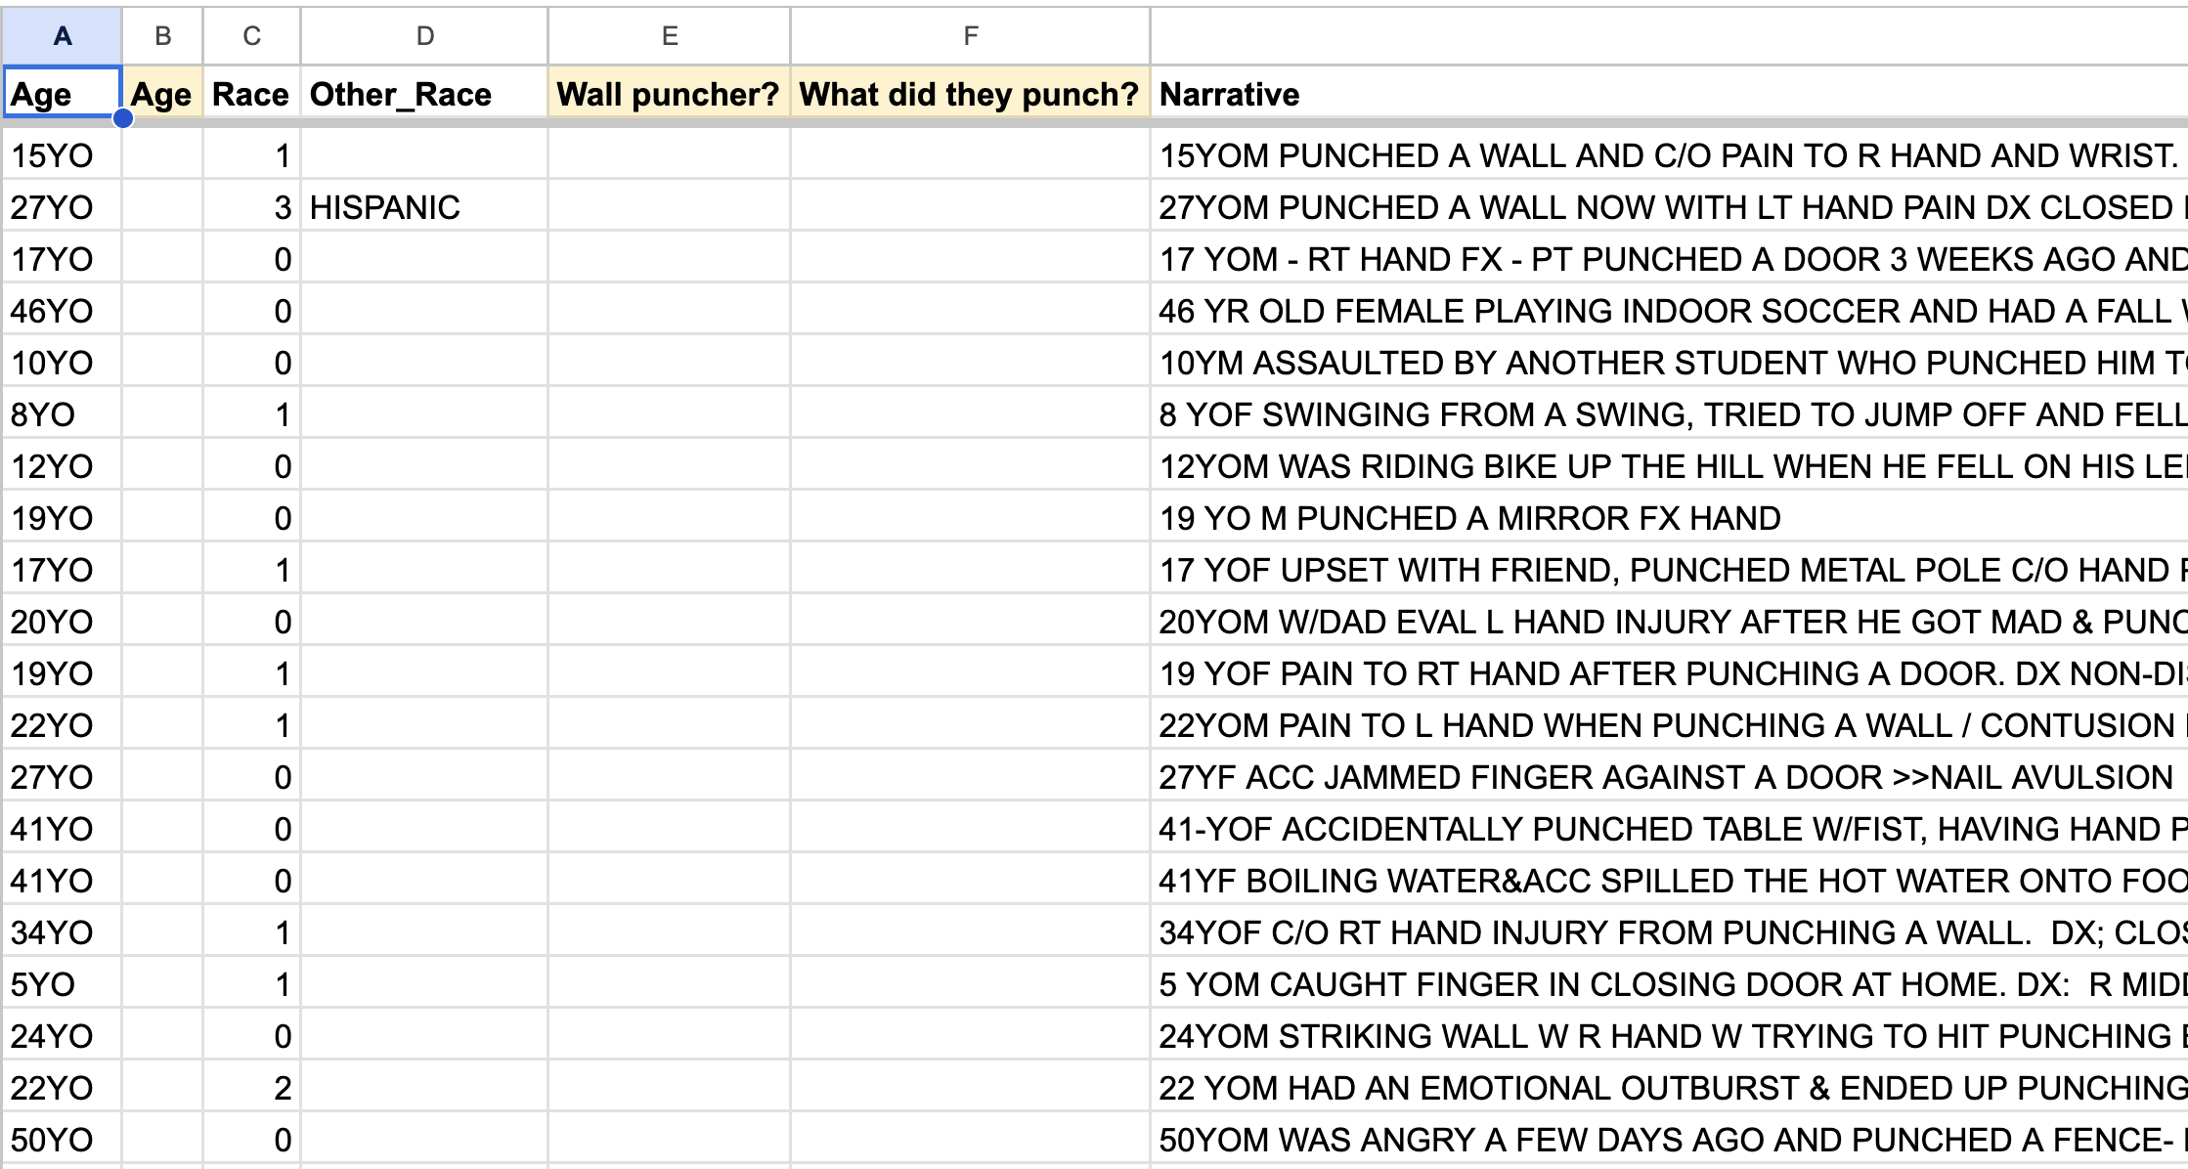
Tab: NEISS

Slide 56
Visit bit.ly/ire25-cleaning
Jonathan Soma
Knight Chair in Data Journalism
Columbia Journalism School
js4571@columbia.edu
jonathansoma.com/everything

